Slide 1


University of Cyprus
at a glance
University House "Anastasios G. Leventis"
1 Panepistimiou Avenue, 2109 Aglantzia, Nicosia,
P.O. Box 20537, 1678 Nicosia, Cyprus
(+357) 22894000
https://www.ucy.ac.cy
info@ucy.ac.cy

Slide 2

General Information
The University of Cyprus was established in 1989
and admitted its first students in 1992
Current number of students
Undergraduate 5.275
PhD and Master 1.758
Staff (1991-2022)
Academic Staff - 343
Research Personnel - 734
Administrative Staff - 476
Total Alumni (1996-2022):
30.091
Total number of outgoing Erasmus+ students for studies
2,911
Total number of incoming Erasmus+ students for studies
2,758
International Recognition of UCY - Rankings
Times World (2022) 401-500
Shanghai (2022) 501-600
QS World University Ranking (2022) 440
US Best Global University Rankings (2022) 566
2

Slide 3
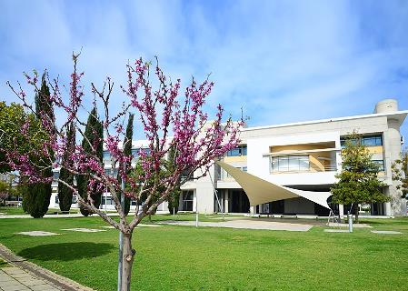
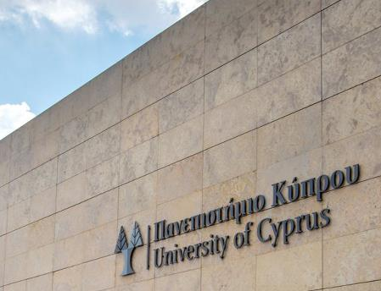
Programmes of Study
Figures
40 Undergraduate programmes
59 Postgraduate programmes (Master’s)
29 Postgraduate programmes in English
43 PhD programmes
14 PhD programmes in English

Slide 4

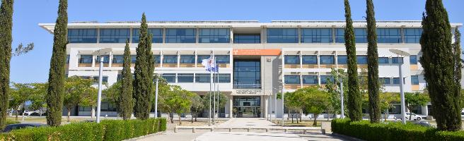
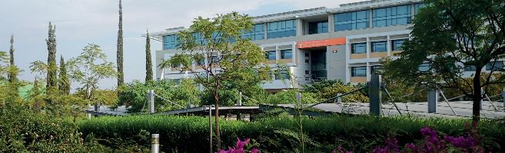
8 Faculties
Faculty of Humanities
Medical School
Faculty of Pure and Applied Sciences
Faculty of Social Sciences and Education
Graduate School
Faculty of Economics and Management
Faculty of Engineering
Faculty of Letters

Slide 5
22 Departments
Faculty of Humanities
Department of English Studies
Department of French and European Studies
Department of Turkish and Middle Eastern Studies
Faculty of Pure and Applied Sciences
Department of Biological Sciences
Department of Mathematics and Statistics
Department of Computer Science
Department of Physics
Department of Chemistry
Faculty of Social Sciences and Education
Department of Education
Department of Social and Political Sciences
Department of Law
Department of Psychology
Faculty of Economics and Management
Department of Business and Public Administration
Department of Accounting and Finance
Department of Economics
Faculty of Engineering
Department of Electrical and Computer Engineering
Department of Mechanical and Manufacturing
Engineering
Department of Civil and Environmental Engineering
Department of Architecture
Faculty of Letters
Department of Byzantine and Modern Greek Studies
Department of History and Archaeology
Department of Classics and Philosophy

Slide 6


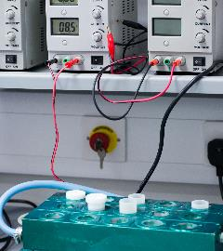
Research
The University of Cyprus has ranked 1st among all organisations from the H2020/WIDENING countries (16 EU members & 11 associated countries that are less advanced in research) in securing competitive funding from the EU’s “Horizon 2020” programme for Research and Innovation.
The University of Cyprus has ranked 135th out of over 40.000 organisations from EU and around the world in securing over €75 million in competitive funding from “Horizon 2020” throughout the duration of the programme 2014-2020.
The University of Cyprus has managed to win 23 ERC projects, an impressive accomplishment considering that ERC funds
only top researchers in Europe, with excellence as the sole criterion
for selection.
The University of Cyprus has ranked 1st in securing funding from
the Cyprus Research and Innovation Foundation (RIF), under the “RESTART 2016-2020 Programme for Research, Technological Development and Innovation”, with total funding of over €33 million.

Slide 7
Internal vs External Research Funding
7

Slide 8
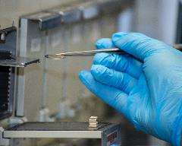

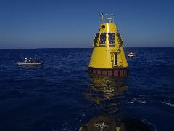
Research Units/Centres
Archaeological Research Unit
Centre of Applied Neuroscience
Centre for Banking and Financial Research
Centre of Excellence in Biobanking and Biomedical Research
Centre for Medieval Arts & Rituals (CeMAR)
Cyprus Neuroscience Research Unit (CNRU)
Economics Research Centre
“EMPHASIS” Research Centre
“KIOS” Research and Innovation Centre of Excellence
“Nireas” International Water Research Centre
Oceanography Centre
Petrondas Institute of Modern Greek Studies
Research Centre for Gender Studies
Research Centre for Sustainable Energy (FOSS)
University of Cyprus Centre for Field Studies
8

Slide 9
Excellence in Learning & Teaching
High Quality of Academic Staff
High Quality of Students
Operational Framework: Rules, policies, awards, codes of conduct, ESG
Teaching & Learning Centre
External Evaluation & Accreditation of Programmes of Study
Research Interface
External Collaboration
Modern facilities, learning systems and materials
Teaching
and Learning
9

Slide 10
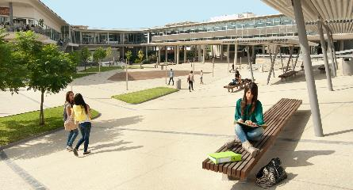

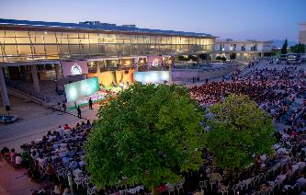


Student life
Student Halls
Social Facilities Centre
Sports Centre
Radio station UCY Voice 95,2 FM
  Mental Health Centre
  Provision of reasonable adjustments
  ensuring equal access to all students
  Student Welfare Assosiation
10

Slide 11
Student Clubs
The Student Club activities extend to a broad spectrum of interests that cover all tastes and demands. They include, among many other activities, music/dance shows, theatre workshops, and seminars on photography, computer science, literature, and philosophy. Furthermore, the Clubs organise charity bazaars, tree-planting events, and excursions to beautiful parts of Cyprus.
The Student Clubs family looks forward to welcoming you to unforgettable moments and new experiences!
1. Archaeology Club
2. Journalism Club
3. International Relations
and Diplomacy Club
4. Volunteers Club
5. Board Games Club
6. UN and EU Club
7. Theatre Club
8. Cinema Club
9. Cypriot Club on Inclusive
Education
10. Sociology Club
11. Literature Club
12. LGBT+ and Friends Club
13. Music Club
14. Law Club
15. Orthodox and Hellenic
Tradition Club
16. Environmental and
Animal Welfare Club
17. Computer Science Club
18. Rhetoric Club
19. Art Club
20. Photography Club
21. Club for Students
with Disabilities
22. Philosophy Club
23. Dance Club
24. Psychology Club
https://ucystudentclubs.cy/
11

Slide 12
Career Centre
The Career Centre (CC) offers comprehensive services to students and alumni related to professional employment, training, and development, as well as liaison with the labour market.
Career Counselling
Students and alumni have the opportunity to arrange a meeting with a CC Officer, for guidance on issues related to their career or for information on continuing their studies at the postgraduate level.
Career Academy for Skills Development
Through training programmes and seminars,
CC adequately prepares students for their smooth integration into the labour market. The Career Academy "Career Accelerator", a 20-hour training programme focused on the essential skills for 2030, empowers students and alumni and enhances their employability.
Student Placements in Businesses and Organisations
All students are given the opportunity to gain professional experience during their studies, through the Student Placement Programme in Companies and Organisations which runs under the “University Labour Market Liaison Offices” Project. (https://2beconnected.ucy.ac.cy/2BC)
Employment of Students and Alumni
The Career Centre informs students and alumni about job vacancies in companies and organisations in Cyprus and abroad through the platform http://careersys.ucy.ac.cy. In addition, students and alumni are given the opportunity to participate
in On-Campus Recruitment Days and arrange job interviews with employers for several job vacancies.
12

Slide 13
Job Mobility
Job Mobility in Europe through the EURES Network
Through the University´s partnering with the EURES Network, students and graduates have the opportunity to receive guidance, information about employment opportunities, language learning, and funding for their job mobility, which is provided to them by the two UCY EURES Advisors.
Networking with Employers
The networking of students and graduates with potential employers is enhanced by the organisation of corporate presentations, called "Meet the Employers", as well as Open Days at companies and organisations.
A two-day Career and Entrepreneurship workshop is also organised, offering a variety of activities in which more than 80 potential employers participate. Through these initiatives, students and alumni gain awareness about the employment prospects in various professional fields.
Continuous Provision of Information
The Career Centre provides continuous information to students and graduates about opportunities for personal and professional development, such as summer and winter schools, competitions, scholarships, conferences,
and seminars that will contribute to the enhancement of their knowledge and skills.
(https://2beconnected.ucy.ac.cy/2BC)
13

Slide 14
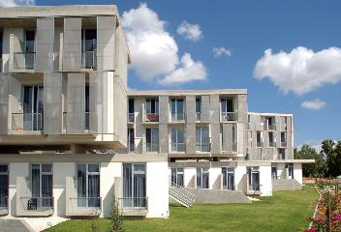
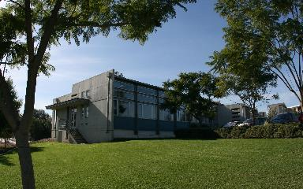
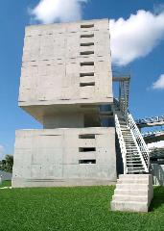
Student Halls
12 independent buildings
208 bedrooms
The following are housed in independent buildings:
Resident Information Centre and Laundry Room
Event Centre
New Student Halls are planned to be built, with a capacity of 730 bedrooms
(700 single rooms, some double rooms) on the University Campus.
14

Slide 15

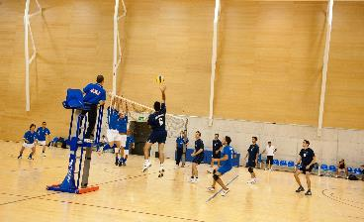
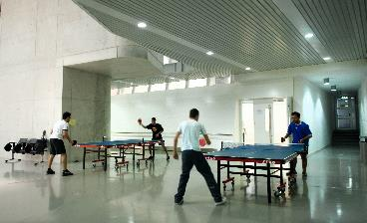
Sports Centre
Sports Services
Fitness centre / gym
Aerobics sessions
Squash / Table tennis
Football and Futsal teams / Volleyball /
Basketball / Tennis / Badminton
Free elective sports courses
Sports summer school for kids
Internal, national, and international sports activities
15

Slide 16


Learning Resource Centre -
"Stelios Ioannou"
In December 2018, the University of Cyprus Library was relocated to its new premises, the Learning Resource Centre – "Stelios Ioannou", on the University Campus. The building was designed by the internationally acclaimed architect Jean Nouvel.
The Library collection includes:
  over 625.000 volumes of books and journals
  over 600.000 e-book subscriptions
  over 30.000 titles of electronic journals
  millions of journal articles in electronic format
  over 190 scientific electronic databases
16

Slide 17
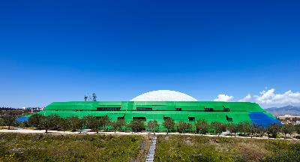
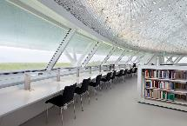
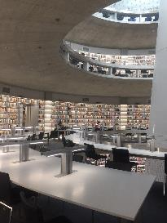
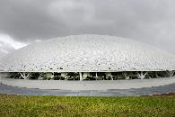
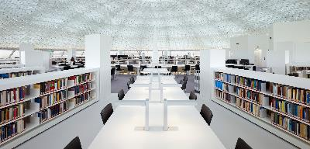
Key Library Actions
  participation in international professional networks (UBER, IFLA, YERUN)
  participation in European research programmes (OpenAIRE, PASTEUR4OA, FOSTER, NI4OS-EUROPE, Yufering, DIOSI, CeOS_SE, etc.)
  operation as the only National Open Access Office OpenAIRE in Cyprus
  active member of the Consortium of Cypriot Libraries (CCyL)
  support for print-disabled students through the provision of teaching and research material and personalised services
17

Slide 18




Alumni
The development of good relations between an academic institution and its alumni is a long-term investment which entails benefits for the institution beyond any financial contribution. The University of Cyprus acknowledges the primary role of our alumni as ambassadors of the University.
Our alumni community comprises 30.091 members (1996-2022).
We engage our alumni with
  Offers and discounts
  Networking opportunities
  Offering news that interests them,
  both at a professional & personal level
  Actively demonstrating the University’s support
  Giving them the opportunity to participate in the University’s activities and offer their support
Website: www.ucy.ac.cy/alumni
UCY ALUMNI COMMUNITY: www. ucyalumni.com
MENTOR programme
Benefits package & membership card
Campaigns
Social media pages
Weekly e-newsletter
Events
18

Slide 19
International relations play a crucial role in the promotion of the University of Cyprus (UCY) abroad, resulting in its good reputation internationally for the quality of both research and teaching. Realising its importance, the University's Rectorate has placed internationalisation at the top of its strategic goals.
Internationalisation at UCY is achieved through a range of activities:
Active membership in more than 65 university networks/associations worldwide, both at international and departmental levels e.g. the European University Association (EUA), the Association of Mediterranean Universities (UNIMED), the Network of Universities from the Capitals of Europe (UNICA))
Signing of Bilateral Agreements of Cooperation with more than130 universities/research institutions in Europe, Australia, the Middle East, Asia, USA, Canada and Africa. These agreements, facilitate student and academic staff exchanges, joint research projects, conferences and exchange of teaching and research material.
Offering of joint degree programmes (at Masters' and Ph.D. levels) in collaboration with other European institutions
Signing of a number of Cotutelle agreements with institutions abroad
Participation in the ERASMUS+ Programme since the academic year 1997/1998 and in the ERASMUS+ International since 2015/2016.
Participation in a number of activities, for the recruitment of international students at the UCY undergraduate and postgraduate programmes of study
Coordination of actions for the promotion of UCY internationally
Participation in the YUFE (Young Universities for the Future of Europe) Alliance
Close cooperation with foreign Embassies and Cyprus and Embassies of the Republic of Cyprus abroad
Close relations with the Cypriot and Greek Diaspora
Organising of visits from international delegations at UCY
Establishment of international institutes in the UCY premises e.g. Aula Cervantes and the Confucius Institute at UCY.
Its international outlook has ranked UCY 84th in the Top 200 World Universities under 50 years old Category of the Times Higher Education World University Rankings 2021.
Internationalisation
International relations play a crucial role in the promotion of the University of Cyprus abroad, resulting in its good reputation internationally for the quality of both research and teaching. Internationalisation at UCY is achieved through a range of activities:
Active membership in more than 65 university networks/associations worldwide, both at international and departmental levels (e.g. the European University Association (EUA), the Association of Mediterranean Universities (UNIMED), the Network of Universities from the Capitals of Europe (UNICA), YERUN etc.)
Participation in the YUFE (Young Universities for the Future of Europe) Alliance
Participation in the ERASMUS+ Programme since the academic year 1997/1998 and in the ERASMUS+ International since 2015/2016.
Establishment of international institutes on the UCY premises, e.g. Aula Cervantes and the Confucius Institute
Conclusion of Bilateral Agreements of Cooperation with more than 130 universities/research institutions in Europe, Australia, the Middle East, Asia, the USA, Canada and Africa. These agreements facilitate student and academic staff exchanges, joint research projects, conferences and the exchange of teaching and research material.
Offering of joint degree programmes (at Masters' and Ph.D. levels) in collaboration with other European institutions
Close cooperation with foreign Embassies in Cyprus and Embassies of the Republic of Cyprus abroad
Close relations with the Cypriot and Greek Diaspora
Participation in a number of activities for the recruitment of international students at undergraduate and postgraduate level
Coordination of actions for the promotion of UCY internationally
Organisation of visits from international delegations at UCY
19

Slide 20


Social Contribution & Impact
The University of Cyprus has had a dynamic impact on the cultural and intellectual life of Cyprus. It organises public lectures and other events which focus on scholarly, scientific and cultural interests, as well as on topics of wider interest. Furthermore, it organises exhibitions, concerts, prize awards and other activities open to the general public. In the framework of social contribution and lifelong learning, UCY runs six Free Universities in cooperation with municipalities and other parties which operate in different cities as well as in rural regions.
With a deep understanding of the importance of achieving the Sustainable Development Goals, the university community directs its teaching and research toward this end.
20

Slide 21
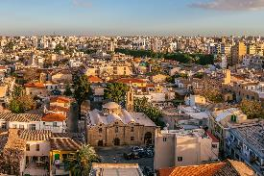
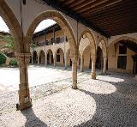

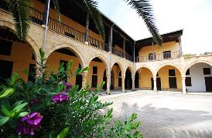
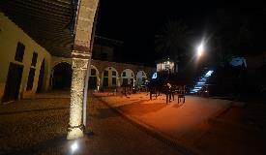
Cultural Centre “Michalis Pieris”
Pursuing its commitment to promoting culture, the University of Cyprus has established a Cultural Centre, located at the Axiothea Mansion, in the historic centre of Nicosia. Carefully restored by the Department of Antiquities, the Mansion also serves as the home of the Theatrical Workshop of the University of Cyprus (THEPAK).
THEPAK’s aims:
To upgrade theatre activities within the University
To contribute to the cultural life
To promote the Hellenic culture and, in particular, the Cypriot literature
Cultural Centre activities:
Cultural Festival of the University of Cyprus
Theatre, dance and music performances, and other events
Exhibitions and lectures

Slide 22
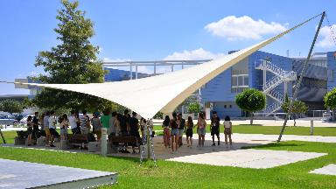
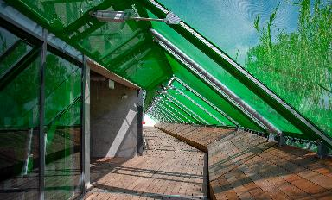
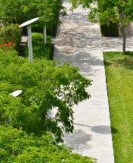
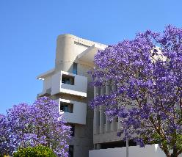
Green University
The University of Cyprus aims to have
the first University campus in the world that
will be completely dependent on solar energy, due to its two photovoltaic parks,
Apollo and Phaethon (the latter to be built
within the buffer zone).
22

Slide 23
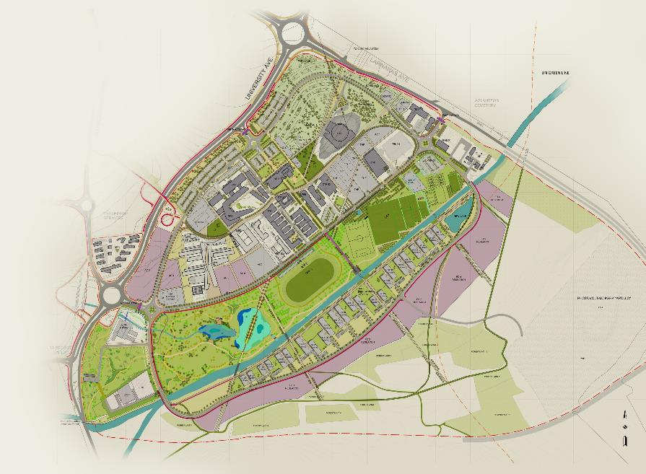
UCY Buildings
Learning Resource Centre -
Library ‘Stelios Ioannou’
New road network and systems infrastructure expansion
Medical School and Health Sciences Building ‘Nicos K. Shakolas’
Department of Biological Sciences and Common Teaching Facilities 03
Faculty of Engineering
Student Residences B
Photovoltaic Park 10MW
Cyprus Cancer Research Institute ‘Nikola Pinedo - David’
University Campus Park
Energy Centre 2
23

Slide 24
CONTACT US
University House "Anastasios G. Leventis"
1 Panepistimiou Avenue, 2109 Aglantzia, Nicosia, P.O. Box 20537, 1678 Nicosia, Cyprus
https://www.ucy.ac.cy/
(+357) 22894000
info@ucy.ac.cy
/UniversityOfCyprus
/UniversityOfCyprus
/UniversityOfCyprus
/UCYOfficial
/school/university-of-cyprus/
24

