Slide 1
Social Skill Instruction: An Effective Discipline for All Students
School Discipline and Positive Behavior Supports
University of Cyprus, Nicosia, Cyprus
June 4th, 2016
Gwendolyn Cartledge – The Ohio State University
Cartledge.1@osu.edu

Slide 2
Organizer
Social Skill Definition & Purpose
Cardinal Rules of Social Skill Training
Social Skills and PBIS
Basic Social Skills Teaching Model
Cultural Factors & Social Skill Instruction (SSI)
Effects of Social Skill Instruction

Slide 3
Social Skill Instruction: An Effective Discipline for All Students
Social skills are behaviors valued by society that are likely to be reinforced/rewarded by others
Rather than punished or extinguished

Slide 4
Why Teach Social Skills?
Although many critical behaviors acquired through informal means – formal instruction can benefit most children
• Positive Relationship Between Task-Related Behaviors and Academic Achievement
Notes:
Social and academic skills are fairly independent but social skills can contribute to overall school and later life success

Slide 5
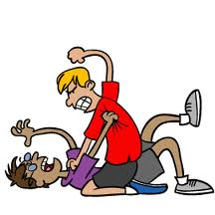
Why Teach Social Skills?
Interpersonal Social Skill Deficiencies Result in Constant Peer and Adult Conflict
Notes:
Some evidence that the ability to relate to and get along with people more important than basic academic/work skills

Slide 6
Why Formal Instruction?
Misperceptions of Behaviors Typically Learned Through Observation
If Properly Perceived, May Not Know When Or How To Perform Desired Behavior
Notes:
Child who misinterprets good natured teasing with aggressive responses
Child accurately perceives that taunting is meant to be hurtful but responds in ways to maintain rather than extinguish the aggression

Slide 7
Why Formal Instruction?
Teachers, Parents Inadvertently Teach Behaviors Wish To Extinguish
Notes:
Adults who use mainly corporal punishment or harsh words w/ children are teaching them that aggressive means are the best ways to control one’s environment

Slide 8
Why Formal Instruction?
Attempt To Counter Negative Models (T.V., Media, Immediate Environment)
Notes:
Some children, particularly impoverished children are disproportionately exposed to negative models in their immediate environment & in the media. Adults also extremely vulnerable to media influence

Slide 9
Social Skill Instruction (SSI)
SSI intended to address issues that interfere with appropriate social development.
SSI typically based on Social Cognitive Theory (Bandura, 1977), emphasizing observational learning
Desired behavior is modeled, learner imitates behavior, receives feedback, & is reinforced/rewarded for correct responding
Notes:
We see this happening in various forms/degrees in natural environment. We are inclined to imitate/emulate others whether good or bad based on perceived rewarding consequences

Slide 10
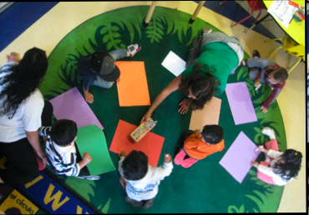
Teaching Social Skills
Cardinal Rules of Social Skills Training– Walker, Ramsey, Gresham, 2005)
    1. Social skills are best taught in naturalistic settings and situations.

Slide 11
2. Social skills should be taught by the same procedures and principles used to teach academic skills.
Notes:
Teach-practice-test

Slide 12
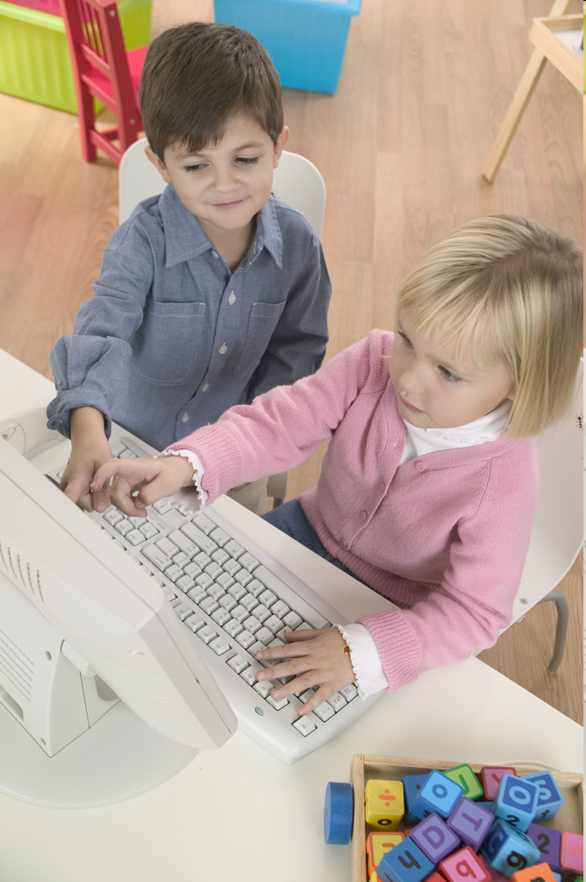
3. There is a direct, positive relationship between the amount and quality (integrity) of social skills training and change in social behavior
Notes:
Continuity of instruction similar to other areas of instruction such as reading. Instruction in various forms should continue throughout the grades

Slide 13
4. Social skills training strategies should be accompanied by reductive techniques to decrease or eliminate competing problem behaviors

Slide 14
Data from One Elementary School:
Frequent Repeaters
Year 2
Year 1
Notes:
Effects on pupil behavior when rely solely on office referrals and punishment

Slide 15
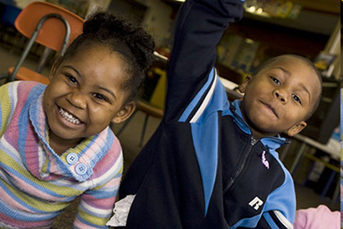
5. To be integrated into a behavioral repertoire, social skills must be at least as efficient and reliable in producing desired outcomes as the competing problem behaviors they are intended to replace
Notes:
Difficult to get child to invite other children to play if play activities are aversive. Need to insure that play with others will be more positive than being alone or enacting aggression against peers

Slide 16
SSI & Three-tiered Model of PBIS
Specialized individual behavioral support for high-risk students (3-5%)
Specialized group behavioral support for at-risk students (7-10%)
Universal schoolwide behavioral support for all students (85-90%)
Adopted from Lewis & Sugai (1999) and Sprague, Sugai, Horner, & Walker (1999)
Notes:
PBIS is designed to meet the unique needs of each school through three levels of implementation.

Slide 17
Schoolwide Behavioral Intervention
Examples of Behavioral Expectations
Setting | Be kind | Be safe | Be cooperative | Be respectful | Be peaceful
Cafeteria | Wait in the line in order | Walk | Sit at assigned table | Clean up after yourself | Calm voices
Playground | Include all who want to play | Use equipment appropriately | Take turns | Keep game rules the same during the game | Return from playground quietly
Notes:
These expectations may need to be operationalized according to specific pupil populations. For example, one school system in MN needed to focus on “being kind” or avoid taunting students of a different faith & cultural group. Most groups need to learn how to go beyond “tolerating” others but how to embrace and appreciate others.

Slide 18
Teaching Social Skills
Alexander is a nine-year-old second- grade student in Ms. Good’s class. Often when he is teased by one of his classmates he throws moderate to severe tantrums. Ms. Good wants to intervene. What behaviors should Ms. Good address?
Notes:
When deciding to teach social skills, need to consider
How extensively the instruction is needed – bullying usually calls for class-wide/school-wide instruction
Evidence- based procedures
Cultural factors.

Slide 19
  Directive Teaching Model
  Define the Skill
  e.g., Responds to teasing or name-calling by ignoring, changing the subject, or some other constructive means
  Assess the Behavior
  e.g., direct observation
  Teach the Social Skill
  e.g., social modeling, cognitive, & affective strategies
  Evaluate Results of Teaching
  e.g., continue observations
  Maintain & Transfer the Skill
  e.g., reinforcement & homework activities

Slide 20
Cultural Factors & SSI
Culturally relevant (CR) instruction is realizing the influence of race, culture, and ethnicity on the ways we teach and the ways children learn (Ladson-Billings, 1995).
Notes:
Our instruction needs to be designed to empower all students to not only lead disciplined, orderly lives but to make major contributions to enhance the lives of others, as well.

Slide 21
Cultural Diversity & Social Learning
Culture is the way of life of a particular group of people. It is integral to every aspect of being, influencing to varying degrees one’s ways of thinking, acting, and ultimately developing.

Slide 22
Basic Principles
Every culture has its own internal coherence, integrity, and logic
No culture is inherently better or worse than another
All persons are to some extent culturally bound (Janzen, 1994)

Slide 23
Characteristics of culture
Culture is learned
Culture is shared
Culture is an adaptation
Culture is a dynamic changing phenomena

Slide 24
Cultural Discontinuity
Child’s
Culture
School’s Culture
Child’s
Culture
School’s Culture
Gap= Low degree of success or failure
Students may be forced to select culture
Overlap = High degree of success

Slide 25
CR Instruction
CR instruction is designed to
Teach what is meaningful to the learner to increase engagement and achievement
Use prior experiences and cultural knowledge to teach to and through the strengths of the culturally diverse learner.
Help children realize how instruction brings about positive changes in their lives

Slide 26
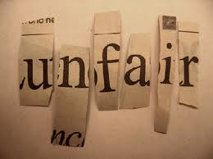
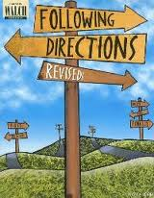
CR SSI Model
(Robinson-Ervin, Cartledge, Keys, 2011)
Teach skills most important to target population
  Review referral data
  Interview students
  Examples: (a) dealing with unfair practices & (b) following directions
Notes:
Research literature indicated one of the most common complaints of black males was perceived being treated unfairly – skill: assertive ways to complaints and perceptions of unfairness
Teachers often complained of failure to follow directions for one study

Slide 27

Rationale for Skill: Questioning What Seems to be Unfair (Cartledge & Kleefeld, 2010)
Appropriately questioning unfair practices is often a difficult social skills for students to acquire
When students do not engage in appropriate questioning practices they are often subjected to discipline measures such as office referrals, suspension, and possibly expulsion.
These consequences can have a negative effect on the school and post-school success of students.

Slide 28

2. Use CR materials to provide a rationale for & teach social skills
– e.g. Freedom Writer’s Diary – black male’s letter complaining about unfair media
treatment of cousin’s
gun death.
Notes:
Persistent problem in schools & community for blacks – particularly black males are issues issues perceived unfair treatment. “Black Lives Matter” – Pres. Obama advised willingness to participate on administrative councils, listen to their positions, present yourself in a way to get your voice heard, devise strategies such as voting for local officials, develop community plans, present them to local officials, participate in local government.

Slide 29
3. Include culturally specific competent peer models
4. Incorporate student’s personal experiences into the instruction
Notes:
Importance of using culturally relevant models that learners can relate to – need to include competent models that are respected & who are able to readily perform the desired skill

Slide 30
5. Where possible, apply the skill within culturally specific environments/contexts, consistent with the learner’s background – where does problem behavior occur and under what circumstances.

Slide 31
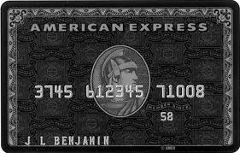
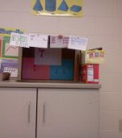
6. Reinforce the behavior
The Black Card The Mini Mart
Black Card Point Guidelines
*0 teacher reprimands = 3 points
*1 to 2 teacher reprimands = 2 points
*3 teacher reprimands= 1 point
*3 or more reprimands or office disciplinary referral = 0 points

Slide 32
CR SSI: Teacher Issues
Color blindness may actually be shortsightedness
Need to be able to see the color, gender, and disability of social behavior
Know something about your culture and realize that not everyone sees the world through your lens
Study and respect the culture of your students. Don’t over generalize or stereotype
Strive to be understanding, caring, fair, and committed.

Slide 33
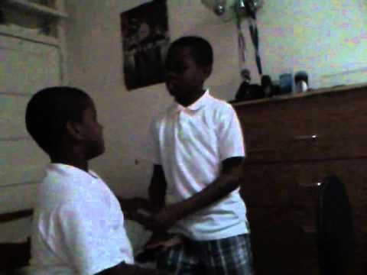
Culturally Responsive Intervention: Do the right thing
Distinguish culturally specific and aberrant behaviors and intervene accordingly with the goal of adaptive classroom behaviors
Example: fighting vs sport of verbal sparring
Notes:
Importance of listening to students, especially if they represent a different culture than your, e.g., verbal sparring, dogs & tattoos for Somali Muslim children

Slide 34
Teaching Social Skills
Alexander is a nine-year-old second- grade student in Ms. Good’s class. Often when he is teased by one of his classmates he throws moderate to severe tantrums. Ms. Good wants to intervene. What behaviors should Ms. Good address?
Notes:
When deciding to teach social skills, need to consider
How extensively the instruction is needed – bullying usually calls for class-wide/school-wide instruction
Evidence- based procedures
Cultural factors.

Slide 35
CR SSI Problem
Ahmed is a 9-year-old second-grade Muslim student in a predominately Christian U.S. classroom. He was bullied by classmates because of his faith and came to his teacher and said “I’m not a terrorist, I’m not a terrorist. The students said, I and my family will have to leave. Where will we go?”
Notes:
Current school problem recently reported in the news

Slide 36
CR SSI Problem
Ahmed is a nine-year-old third grade student. He was born in a Kenyan refugee camp and the family emigrated to the U.S. He was recently diagnosed with a moderate hearing loss and has become defiant over the past two months. He has no hearing aid because his family cannot afford one.

Slide 37
The teacher caught him cheating on the weekly spelling test where he was looking on a classmate’s paper while the teacher dictated the words. He said he could not hear the teacher but he was sent to the principal and then punished. In addition to cheating, the teacher is extremely concerned that Ahmed has been taking things off her desk without asking permission

Slide 38
What are the behaviors of concern?
What are the contributing disability factors?
What are the contributing cultural factors?
  What do you know about the Somali culture?
What do you think would be the best course of action in this case?
Notes:
Adult defiance, cheating, taking things from teacher’s desk
Disability – hearing loss not corrected with hearing aid
Somali culture – living in refugee camp where resources so limited people took w/ impunity whatever was available
Approach should not be primarily punitive. First make sure child understands the culture of school and larger U.S. society. Provide direct small group/individual instruction on skills such as (a) How to request items he wants/how to appropriately determine how to get items he wants, (b) How to appropriately request more information when he cannot hear a teacher direction, & ©,How to appropriately and promptly respond when directed by authority figure.
Mild punishing consequences applied only when determined learner know how to perform desired behavior(s) and elects not to do so. Continue with instruction, mild consequences and data collection until determined instruction has taken hold or it is totally ineffective and another course of action is needed.

Slide 39
Culturally different behaviors are not equivalent to social skill deficits
School personnel need to accurately perceive & respond to children’s social behaviors with more than punishing consequences
Interventions need to be positive, constructive, and timely focused on helping students derive maximum benefit from their schooling and social relationships

Slide 40
Effects of Social Skill Instruction
Modest but encouraging empirical evidence that SSI can effectively modulate problem behaviors for children (Albrecht et al., 2015), including children low income students from culturally and linguistically diverse backgrounds (Bardon et al., 2008; Daunic et al., 2013; Robinson-Ervin et al., in press).

