Slide 1
Working with a Few Students at Tier III: Supporting the Individual Needs of Students with Chronic and Severe Behaviors within a SWPBS Framework
Tim Lewis, Ph.D.
University of Missouri
OSEP Center on Positive Behavioral Interventions and Supports
pbis.org

Slide 2
Big Ideas
Understand interaction between behavior and the teaching environment
Build Positive Behavior Support Plans that teach pro-social “replacement” behaviors
Create environments to support the use of pro-social behaviors
  Around individual student need
  Classroom
  School-wide
Create efficient systems to conduct and implement

Slide 3
Designing School-Wide Systems for Student Success
Academic Systems
Behavioral Systems
Intensive, Individual Interventions
Individual Students
Assessment-based
High Intensity
Intensive, Individual Interventions
Individual Students
Assessment-based
Intense, durable procedures
1-5%
1-5%
Targeted Group Interventions
Some students (at-risk)
High efficiency
Rapid response
5-10%
5-10%
Targeted Group Interventions
Some students (at-risk)
High efficiency
Rapid response
Universal Interventions
All students
Preventive, proactive
80-90%
80-90%
Universal Interventions
All settings, all students
Preventive, proactive

Slide 4
Tier III (individualized support)
When small group not sufficient
When problem intense and chronic
Driven by Functional Behavioral Assessment
Connections to Mental Health and Community Agencies (Integrated Framework Monograph)
Part of a continuum – must link to universal school-wide PBS system

Slide 5
What is a Functional Behavioral Assessment
“A process for gathering information used to maximize the effectiveness and efficiency of behavioral support” (O’Neil et al.)
  Operational definition of behavior
  Identification of events that are functionally related to behavior
  Identification of consequences that maintain behavior
  Hypothesis about function of behavior
  Direct observation to confirm/support hypothesis

Slide 6
Why Conduct a Functional Behavioral Assessment

Slide 8
The Key
Behavior is functionally related to the teaching environment

Slide 9
Basics
Focus on observable behavior
  Label free approach
  Acknowledgement of other factors
Instructional approach
Emphasis on understanding the principles of behavior not specific forms or “cook book” strategies
Rule out other explanations
Move from personal experience with “discipline”

Slide 10
FBA – PBS Plan Process
Success requires:
Individual(s) with expertise in FBA-PBS
Fluency with a clear process among all staff whereby roles are clearly defined
A basic understanding of Applied Behavior Analysis (Behavior is functionally related to the teaching environment) among all school staff

Slide 11
Essential Steps to Individual PBS Plans
Request for assistance
Operationally define problem/replacement behavior
Background/archival data/ data collection/Environmental Assessment
Functional Behavioral Assessment
  Indirect measures
  Direct observation
Develop hypothesis regarding function of problem behavior
Develop a PBS plan
  Social skill instruction
  Self management
  Environmental modifications
Implement, Monitor and Evaluate progress

Slide 12
Essential Steps to Individual PBS Plans
Request for assistance
Operationally define problem/replacement behavior
Background/archival data collection/Environmental Assessment
Functional Behavioral Assessment
  Indirect measures
  Direct observation
Develop hypothesis regarding function of problem behavior
Develop a PBS plan
  Social skill instruction
  Self management
  Environmental modifications
Implement, Monitor and Evaluate progress

Slide 13
Behaviors Have Dimensions
Describe behavior such that it is observable and measurable
Frequency
Topography
Locus
Duration
Latency
Force or intensity

Slide 14
Essential Steps to Individual PBS Plans
Request for assistance
Operationally define problem/replacement behavior
Background/archival data collection/Environmental Assessment
Functional Behavioral Assessment
  Indirect measures
  Direct observation
Develop hypothesis regarding function of problem behavior
Develop a PBS plan
  Social skill instruction
  Self management
  Environmental modifications
Implement, Monitor and Evaluate progress

Slide 15
Record Review
Attendance
Health history
Onset of current problems
Past services or interventions
Effectiveness of previous interventions
Previous educational functioning
Previous assessments
Sensory screening
Discipline Referrals

Slide 16
Effective Instruction in a “Nutshell”
Environmental arrangement
  Designed to reach defined outcomes
Behavior Management
  Rules
  Routines
  Reinforcement
Instructional strategies
  Opportunities to respond
  Promotes high levels of accuracy (80%)
  Specific feedback

Slide 17
Essential Steps to Individual PBS Plans
Request for assistance
Operationally define problem/replacement behavior
Background/archival data/ data collection/Environmental Assessment
Functional Behavioral Assessment
  Indirect measures
  Direct observation
Develop hypothesis regarding function of problem behavior
Develop a PBS plan
  Social skill instruction
  Self management
  Environmental modifications
Implement, Monitor and Evaluate progress

Slide 18
Moving beyond the form of behavior...
Applied Behavior Analysis

Slide 19
The Basics
Behavior is learned
Do not assume children know your rules, expectations, or social skills
Every social interaction you have with a child teaches him/her something

Slide 22
The Basics
Behavior communicates need
Children engage in behavior(s) to "get" what they find reinforcing or to "avoid" what they find aversive
Need is determined by observing what happens prior to and immediately after behavior

Slide 23
The Basics: Applied Behavior Analysis
Concerned with the functional relationships between BEHAVIOR and the TEACHING ENVIRONMENT
“Functional Relationships”
  When “X” happens, high degree of likelihood “Y” will result

Slide 24
Teaching Environment
Events that happen prior to school or class (Setting Event)
Events that “trigger” or prompt a behavior (Antecedent)
Events that follow a behavior (Consequent)

Slide 25
Functional relationships with the Teaching Environment
Events that follow behavior
Following a student behavior the environment “gives” something to the student and student behavior maintains or increases -- what ever was given is reinforcing to that individual

Slide 26
Functional relationships with the Teaching Environment
Events that follow behavior
Following a behavior the environment allows the student to stop an activity or is removed from the situation and the student behavior maintains or increases -- the event the student is avoiding is aversive to that individual

Slide 27
Functional relationships with the Teaching Environment
Events that precede behavior
Events in the environment can “trigger” challenging behavior - they serve as cues for the student to perform a behavior because the student can predict the outcome when the cue is present

Slide 28
What antecedent events reliably precede problem behavior?
When does the behavior occur?
  What activities are taking place?
  What people are present?
  How is the environment arranged?
When is the problem behavior absent?
  What activities are taking place?
  What people are present?
  How is the environment arranged?

Slide 29
Are there setting events that reliably precede problem behaviors?
What earlier events seem to make the behavior more likely?
  Illness?
  Is the behavior cyclic?
  Have there been changes at home?
  Is the student having interpersonal problems?

Slide 30
Functional Assessment
Pre-Assessment/Indirect
Interviews
Rating Scales
Student Guided
Direct Observation
A-B-C
Checklists

Slide 31
Functional Assessment
Forms to assist in the process

Slide 32
FA Interview
Define the behavior
When does it occur?
What are you doing?
What do the peers do?
Where does it occur?
Are there times when the behavior doesn’t occur?
Is the behavior more likely to occur given certain tasks?
Are there events that happen outside of the classroom that exacerbate the problem?

Slide 33
Problem Behavior Questionnaire

Slide 35
Functional Assessment Checklist for Teachers and Staff
(FACTS-Part A – Problem Identification)
Student/Grade: Date:
Interviewer: Respondent(s):
Student Profile: Please identify at least three strengths or contributions the student brings to school.
Problem Behavior(s): Identify & Describe Problem Behaviors Specifically:
___Tardy ___Unresponsive ___Withdrawn | ___Inappropriate Language ___Fight/Physical Aggressive ___Verbal Harassment | ___Disruptive ___Insubordination ___Work not done | ___Theft ___Vandalism ___Other_________________
Describe the problem behavior(s) specifically - - What does it look like/sound like :
PBIS.org

Slide 37
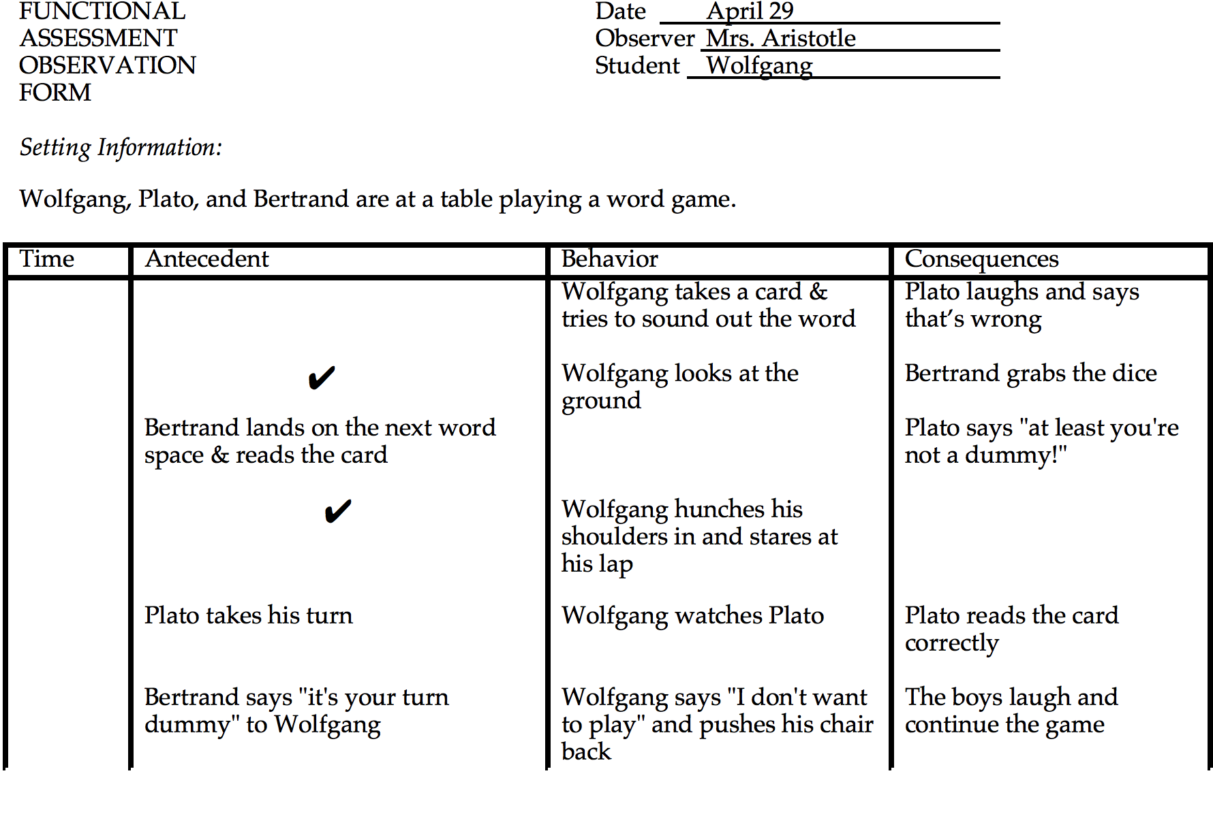

Slide 38
Essential Steps to
Individual PBS Plans
Request for assistance
Operationally define problem/replacement behavior
Background/archival data/ data collection/Environmental Assessment
Functional Behavioral Assessment
  Indirect measures
  Direct observation
Develop hypothesis regarding function of problem behavior
Develop a PBS plan
  Social skill instruction
  Self management
  Environmental modifications
Implement, Monitor and Evaluate progress

Slide 39
Outcome = Hypothesis
Hypothesis statement regarding the likely functions of the problem behavior and the context (social and environmental conditions) in which it is most likely to occur.

Slide 40
Hypothesis
When this occurs….
The student does….
To get/avoid...

Slide 41
Functional Assessment : Common Hypotheses
Receive attention from adults & peers
Receive tangible objects or access to preferred activities
Avoids interaction with adults & peers
Avoids tasks or responsibilities

Slide 42
Essential Steps to
Individual PBS Plans
Request for assistance
Operationally define problem/replacement behavior
Background/archival data/ data collection/Environmental Assessment
Functional Behavioral Assessment
  Indirect measures
  Direct observation
Develop hypothesis regarding function of problem behavior
Develop a PBS plan
  Social skill instruction
  Self management
  Environmental modifications
Implement, Monitor and Evaluate progress

Slide 43
Developing Positive Behavior Support Plans
Addressing the Function of Problem Behavior by Teaching Functionally Equivalent Replacement Behaviors

Slide 44
Functional-Based Interventions (BIP)
Teach replacement behavior(s) that result in same/similar outcome
Environment should not allow problem behavior to result in previous outcomes
Replacement behavior should be more efficient than problem behavior

Slide 45
Positive Behavioral Support Plans
Describe what behaviors are expected of the student and how they will be taught and supported
Describe the changes in the environment that are designed to alter a student’s behavior
  Describe what adults will do differently in an effort to alter what the child does
  Describe what academic, schedule, etc., changes will be made to support new behavior

Slide 46
Four themes in developing PBS plans
Logical link between functional assessment results and procedures employed
Consistent with basic principles of behavior
Clear definition of changes in the behavior of implementers.
Good fit with the values, skills and resources of the implementers. O’Neill et al (1997)

Slide 47
Competing Behavior Pathways Model
Desired
Alternative
Maintaining
Consequences
Setting
Events
Triggering
Antecedents
Problem
Behavior
Maintaining
Consequences
Acceptable
Alternative
Setting
Event
Manipulations
Antecedent
Manipulations
Behavior
Teaching
Consequence
Manipulations
Sugai, Lewis-Palmer & Hagan, 1999

Slide 48
Setting Events | Predictors | Behavior | Consequences
• Playground monitor debriefs student prior to coming into building. | • Change seating arrangement during reading class. • Pre-correct class RE rules of cooperative groups. | • Set up cooperative peer groups. • Identify appropriate peers and teach cooperative strategies. • Teach rules and skills of cooperative groups to target student. • Role play cooperative learning with peers and target student. • Monitor progress (momentary time sampling) | • Verbal praise when on-task (VI 3 minutes). • Error correction for off-task. • Free time with peers for meeting established daily criteria.

Slide 49
Essential Steps to
Individual PBS Plans
Request for assistance
Operationally define problem/replacement behavior
Background/archival data/ data collection/Environmental Assessment
Functional Behavioral Assessment
  Indirect measures
  Direct observation
Develop hypothesis regarding function of problem behavior
Develop a PBS plan
  Social skill instruction
  Self management
  Environmental modifications
Implement, Monitor and Evaluate progress

Slide 50
Monitor & Evaluate
Implementation fidelity
Student progress monitoring
  Environmental changes
  Re-teach skills
  Increase Reinforcement
  Re-assessment

