Slide 1
SWPBS in the Classroom
Trish Scardina
North Carolina Department of Public Instruction
Trish.Scardina@dpi.nc.gov

Slide 2
Expectations
Be Respectful
  Listen to others
  Follow the attention signal
Be Responsible
  Ask questions
  Participate
Be Kind
  Think with an open mind
  Use positive words

Slide 3

Academic Learning Time
There is no doubt that academic learning time–the amount of time that students are actively, successfully, and productively engaged in learning–is a strong
determinant of achievement.
Notes:
The Effective Classroom Practices have been identified to increase the likelihood of appropriate behavior and decrease problem behavior while increasing academic learning time. It only makes sense that the amount of time students are engaged in learning will positively impact achievement.

Slide 4
Academic Learning Time
Instructional Time–the amount of the allocated time that actually results in teaching.
Engaged Time–the amount of instructional time where students are actively engaged in learning.
Notes:
Academic Learning Time can be divided into Instructional time. Instructional time is the allocated time that actually results in teaching. Engaged Time is the amount of instructional time that students are actively engaged in learning.

Slide 5
Academic learning time
Instructional Time
Engaged Tim
  Classroom Expectations
  Classroom Procedures & Routines
  Encouraging Expected Behavior
  Discouraging Inappropriate Behavior
  Active Supervision
  Opportunities to Respond
  Activity Sequencing & Choice
  Task Difficulty
Notes:
Instructional Time, the time we have to teach, is diminished if we have unclear procedures, disruptive student behavior, disciplinary responses, lengthy transitions, etc.
There are four Effective Classroom Practices to help us gain more instructional time to teach:
Classroom Expectations
Classroom Procedures and Routines
Encouraging Expected Behavior
Discouraging Inappropriate Behavior
Engaged Time which is amount of instructional time when students are actively engaged in learning, is diminished if we have ineffective strategies such as inactive supervision, limited opportunities for students to respond, poor task selection, etc.
There are four Effective Classroom Practices that positively impact engaged time:
Active Supervision
Opportunities to Respond
Activity Sequencing and Choice
Task Difficulty

Slide 6
5%
CONTINUUM OF
POSITIVE BEHAVIOR INTERVENTION AND
SUPPORT
FBA/BIP
De-escalation
15%
Social Skills
Mentoring
Check In
Self Management
Classroom Based Intervention
80%
Defining & Teaching Expectations
Routines & Procedures
Reinforcement Systems
Effective Consequences
Notes:
Key Points:
This graphic shows how PBIS is a continuum; Universal interventions will support the majority of students, additional secondary and tertiary interventions support a small number of students who need additional interventions to be successful. If all interventions are in place then the smallest number of students as possible will need the most intensive help.
Universal (green): Universal strategies are for all students. Stress the importance of having universals in place before adding more intensive strategies for at risk and high risk students You will be tempted to start with the top, but this is an inefficient use of resources. Effectively implemented universals (listed in the green section on the slide) will assist the majority of students to demonstrate appropriate behavior. However, universals will not decrease behavior to zero.
Strategies for students with at-risk behavior (yellow): The next layer of intervention (strategies listed on slide). These students need additional supports to learn and practice pro-social behavior.
Strategies for students with high-risk behavior (red): After first two layers of interventions, you should be left with a small group of students who need intensive individualized support. These students need highly individualized plans .
Other Key Points
If you invert the triangle you will see the amount of staff time required at each level.
Many schools initially say that we have less than 80% of our students who are in the green area and more than 20% in the top two levels. This indicates a need for stronger, more effective school-wide systems. This graphic is when PBS is in place in schools and working.
You will always have a 5% regardless of your population. Your system-wide, secondary, and tertiary interventions can vary according to students’ overall needs.
Remind teams they will be doing double duty for a while: you will be dealing with individual kids as you are creating the system of universal support. Without building universal systems of support, interventions implemented for individual students will not be sustainable.
Incidentally, we find that school faculty will be distributed the same way in regard to their “buy in” and support needed to implement PBS.

Slide 7
Classroom Management
Classroom management refers to all of the things that an educator does to organize students, space, time, and materials, so that instruction in content and student learning can take place.
Notes:
7
Key Points:
The classroom is yours to to manage. You can use space, organization, structure, materials, and time to maximize positive behavior and learning. Things can still go wrong, but are less likely, and usually more manageable with better classroom management

Slide 8
Best Practice for Teachers
Academic Instruction
Social Skills Instruction
Present the Lesson
Tell
Test
Guided Practice
Assess
Show
Indepen-dent Practice
Practice
Notes:
Procedures for Teaching Expected Behaviors
Social Skills Instruction: We teach social skills just as we would any other skill
teach the expected behavior
demonstrate the skill
students practice the skill
Assess the skill (How do we test behavior skills?)
Then repeat as needed…
Embed in curriculum—the behaviors should be taught throughout the day. The teacher should become fluent in using the language of PBIS by providing precorrects (reminders) and feedback that tie to the school expectations (“Be Responsible” or “Be Kind,” etc.) and rules (“keeping hands and feet to self”).
As your PBIS team thinks about how to support teachers so they will teach your school expectations, you can provide scripted lesson plans or one page lesson reviews.
Practice, practice, practice—in all settings in the school. This may require the PBIS team to figure out a schedule so classes can practice in the cafeteria, for example.
Social skill instruction
Embed in curriculum
Practice, practice, and practice

Slide 9
Classroom Management Plan
At the end of each component, you will be asked to apply learning to your own classroom management plan.
Use the classroom management templates to guide you.
Your overall plan should include:
  Routines and procedures
  Classroom expectations
  Methods for teaching expectations
  Procedures for encouraging positive behavior
  Procedures for responding to problem behavior
Notes:
Key Points:
Components result in one comprehensive plan that will describe all of you classroom management strategies. This is a useful tool for communicating with substitutes, parents and even students if developmentally appropriate.

Slide 10
Routines and procedures

Slide 11
Why Identify and Focus on Classroom
Procedures and Routines?
Tell
Assess
Show
Practice
Notes:
When students can predict the events throughout their school day, they are more likely to be engaged and less likely to display problem behavior. One way to increase predictability in a classroom is to establish routines, particularly early in the school year (Kern & Clemens, 2007, p. 67).
Research tells us that procedures:
Increase instructional time by preventing problem behavior.
Free teachers from correcting misbehavior
Improve classroom climate
Create shared ownership of the classroom
Develop self-discipline

Slide 12
How Do We Ensure that Identified Procedures Become Student Routines?
Tell
Assess
Show
Practice
Notes:
For students to learn the procedures and to routinely, independently and efficiently use them, we need to:
Directly teach students the procedures just as we would teach cafeteria procedures, through discussion and role play.
Have students practice the use of the procedures regularly so they become routinely used.
Encourage/Reinforce students when they use them. Reinforcement needs to continue throughout the school year.

Slide 13
Procedures Needed By Most Teachers
  Attention signal
  Beginning of Day or Class Procedures
  Opening Activities Subroutines
  Student Participation in Whole Group Instruction
  Student Participation in Cooperative Group Instruction
  Student Participation in Independent Seatwork
  Managing Student Assignments
  Ending Routines
List of Procedures
Notes:
Attention signal
Beginning Procedures
Entering the Classroom
Opening Activities
Dealing with Tardies
Opening Activities Subroutines
Finished with Work
Student not Prepared with Materials
Student Returning After Absence
Student Participation in Whole Group Instruction
Student Participation in Cooperative Group Instruction
Student Participation in Independent Seatwork
Ending Procedures
Manage Student Assignments
Classwork and Homework Assignments
Collecting and Returning Completed Work
Note: Teachers should also plan "wind-up" and "wind-down" activities as they are designing beginning and ending procedures. A good wind-up activity for the beginning of a session is a three-minute facts timing. A good wind-down activity is a large-group review session.
Handout:
List of Procedures

Slide 14

Attention Signal
When I raise my hand and say “may I have your attention please.
You will put down all of your materials.
Raise your hand
Look at me
Close your mouths
That means the entire class should be absolutely silent and still within 5 seconds.
May I have your attention please?”
Notes:
Here is one example

Slide 15
Participating in Whole Class Instruction at Your Desk/Table
Bring out materials as instructed by your teacher.
Stay in your seat unless instructed otherwise by your teacher.
Listen carefully to the instruction from the teacher.
Raise your hand to speak and speak only with teacher permission.
Listen carefully to other students when they are speaking.
Notes:
Here is another example

Slide 16

Discussion
What are some reasons why this highly effective proactive approach to classroom discipline is under utilized?
Do the teachers in your building have clear procedures for their classroom activities?
Would having procedures for all classrooms serve your school well?

Slide 17
Activity:
Creating a List of Classroom Procedures
Think through the many activities of your day.
Now, read through the lists of possible classroom procedures on Lists of Classroom Procedures handout.
Put a Check Mark ✓ by any that you have applied in your classroom.
Put an × by any that you think you need to develop.
Add any that might be missing.
Share with a partner.
Notes:
Handout:
Lists of Classroom Procedures

Slide 18
Know the Process for Ensuring Effective Student Routines
Tell
Assess
Show
Practice

Slide 19
Step 1:
Define Procedures
Tell
Assess
Show
Practice
Notes:
Procedures are a task analysis or sequential list of steps necessary to successfully complete activity.

Slide 20
Effective Procedures Have Certain Features
Procedures Have: | Example: Entering the Classroom
A clear desired outcome | Opening work started and completed
Clear expectations for desired student behavior – steps to procedure | Enter the room quietly. Take homework folder and any other necessary items out of book bag. Hang up coat and book bag Place lunch on the shelf. Sharpen 2 pencils Sit down at seat
A plan for how students will get help if needed | Help: Raise hand
Clear expectations for conversation/talking | Conversation: No conversation after entering class
A consistent signal to students to engage in procedure | Instruction on board and reminders by teacher as students enter the classroom
A plan for how the teacher will supervise the procedure | Stand at the door and welcome students in
Notes:
Effective Procedures have certain features included in them.

Slide 21
Effective Procedures Meet Certain Guidelines
5 Guidelines for Developing Procedures
Observable | I can see it!
Measurable | I can count it!
Positively Stated | Communicate what you want students to do!
Understandable | Vocabulary consistent with students’ grade/ability level and is developmentally appropriate.
Always applicable | Has few exceptions. You almost always want students to follow the procedure exactly as you designed it.
Notes:
Procedures should be Observable, Measurable, Positively stated, Understandable, Always applicable

Slide 22
Discussion: Questions???
What questions do you have about creating clear, specific classroom procedures?

Slide 23
Activity: Procedure Writing
Select one procedure you put an × by during previous activity, one that you need to develop.
Complete the chart for your procedure.
When done, ask yourself:
  Do your steps meet OMPUA guidelines?
  Does the procedure create a vision of a successful student in that activity?
Be prepared to share your procedure with the group.
Notes:
Now that you have put an X on some of the procedures you need to develop on your handout, we are going to take some time to write the procedure.
Remember to consider OMPUA—observable, measureable, positively stated, understandable and always applicable.
Handout:
Procedure Worksheet
After some time to work, ask for volunteers to share their procedures.

Slide 24
Tell
Step 2:
Teach Students
Assess
Show
Practice
Notes:
Developing Classroom Procedures is Not Sufficient. In order to make procedures routines:
Teach the most important, key procedures over a period of days, one or two at a time.
Teach the steps of the routine and explain the rationale behind the routine or procedure.
Model the routine or procedure for the students.
Give the students non-examples of compliance.
Have the students (or one student) model the procedure.
Review how the student or students did.
Teach the less important routines and procedure by simply stating the routine or procedure, monitoring it, and reinforcing it when necessary.
Be consistent . Don't give up after a few days. The time spent teaching, monitoring and reinforcing routines and procedures during the first three weeks of school will pay tremendous dividends. If the routines and procedures are established at the beginning of the year, the entire rest of the year will be more enjoyable and productive for both you and your students.
You just identified classroom procedures, now you want to make your classroom procedures effective by teaching them. After the classroom procedures have been defined, it is helpful to post them in the classroom in a prominent spot where you and your students can refer to them regularly and frequently. Posting is not enough. Just like we teach our dismissal and cafeteria procedures, we need to teach procedures to ensure students know them.

Slide 25
Create a Behavioral Lesson Plan
Components of a Behavioral Lesson Plan
Tell | Tell me specifically how to do it
Show | Show me specifically how to do it
Do | Let me practice doing it and give me specific feedback on how well I did. Allow me to correct mistakes.
Review | Review the specific steps with me again.
Notes:
Handout:
Tell, Show, Do, Review Lesson Plan

Slide 26
Tell
Step 3:
Set up Practice for Students
Assess
Show
Practice
Notes:
Developing Classroom Procedures is Not Sufficient. In order to make procedures routines:
Procedures must be directly taught to students and
Students must be allowed to practice the routine
Once all our classroom procedures have been identified, it is equally important that the procedures we want students to demonstrate are systematically taught. This means there needs to be a plan for when and how classroom procedures will be taught to students.

Slide 27
Example Schedule for Teaching
Classroom Procedures
First Grading Period
  Teach rules and procedures for all areas of school, including individual classrooms, during first week of school
    Provide opportunities for review and practice
    Provide frequent reinforcement/acknowledgement
  After first week, review rules and procedures 2 or 3 times per week
    Rapid pace, oral review during first few minutes of class
    Surprise quizzes about procedures for extra credit points
    Divide into teams, ask questions about procedures, award points
Notes:
Handout:
Schedule for Teaching and Reviewing Rules and Procedures

Slide 28
Tell
Assess
Show
Step 4:
Encourage the Appropriate Behavior
Practice
Use Specific Feedback Module
Notes:
Developing Classroom Procedures is Not Sufficient. In order to make procedures routines:
Procedures must be directly taught to students and
Students must be allowed to practice the routine
Students must get Specific Feedback on their skill use (See Specific Feedback Module)

Slide 29
Know the Steps to Effective Student Rules
Tell
Assess
Show
Practice

Slide 30
HOW ARE EXPECTATIONS AND RULES/SPECIFIC BEHAVIORS DIFFERENT?
Expectations | Rules/Behaviors
Expectations are broadly stated and are values, character traits that students strive to meet | Rules describe specific behaviors: Observable Measurable
3-5 positively stated ideals that can apply to all areas of life. | Rules apply to limited settings i.e. School environment
Consistent with school’s mission statement | Rules clarify behaviors for specific settings and as applied to expectations look different in different settings.
Expected of all faculty and students | Rules define what adults want students to do
Notes:
What is the difference between Expectations and Rules? Expectations are the ideals for which we are striving aka character traits. Rules are specific behavioral statements and are some of the behaviors that students will display to demonstrate the School Wide expectations in your room. For example, one way to show “respect” (expectation) in your room may be by “keeping your hands and feet to self” (rule).

Slide 31
Effective Rules Meet Certain Guidelines
5 Guidelines for Developing Rules
Observable | I can see it!
Measurable | I can count it!
Positively Stated | Communicate what we want students to do!
Understandable | Vocabulary consistent with students’ grade/ability level and is developmentally appropriate.
Always applicable | Has no exceptions. You always want students to follow the rules throughout the entire day while at school.
Notes:
Procedures should be Observable, Measurable, Positively stated, Understandable, Always applicable
Classroom expectations and behaviors or rules must be consistent with schoolwide expectations and rules. School rules are in effect in the classroom. What we identify as classroom rules are additional, extra or specific to the classroom setting – anything not already covered by the schoolwide rules that you want in effect in your classroom.

Slide 32
Which of These Follow the
OMPUA Guidelines?
Keep hands and feet to yourself
Turn in completed assignment
Respect others
Walk in the classroom
Don’t run
Notes:
Turn to a partner. Talk and decide… which of these statements meet the 5 guidelines for writing rules? Remember, to be considered a “rule,” the behavior must be observable, measureable, positively stated, understandable, and always applicable.
Answers:
Keep hands and feet to yourself (good)
Turn in completed assignment (good)
Respect others (not observable, measureable, understandable)
Walk in the classroom (good)
Don’t run (isn’t positively stated)

Slide 33
Which of These Follow the
OMPUA Guidelines?
Think before responding
Come to class on time, prepared with all supplies and assignments
Be responsible
Be ready to learn
Sit in your seat unless you have permission to leave it
Notes:
Turn to a partner. Talk and decide… which of these statements meet the 5 guidelines for writing rules? Remember, to be considered a “rule,” the behavior must be observable, measureable, positively stated, understandable, and always applicable.
Trainer:
Answers:
Think before responding (not observable, measureable)
Come to class on time, prepared with all supplies and assignments (good)
Be responsible (not observable, measureable, understandable)
Be ready to learn (not understandable)
Sit in your seat unless you have permission to leave it (good)

Slide 34
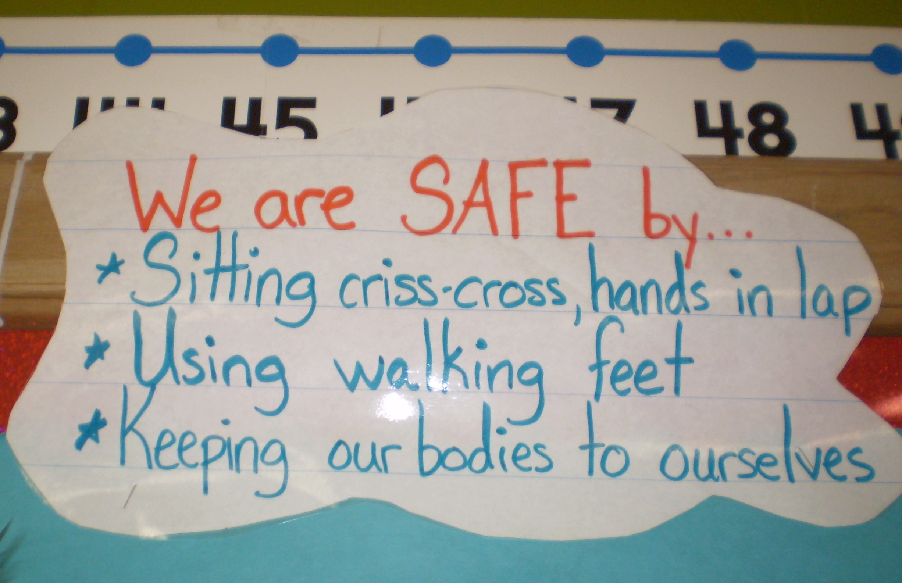
Notes:
Here is an example of classroom expectations that are:
Tied to the schoolwide expectation of safe and the behaviors follow OMPUA guidelines.

Slide 35
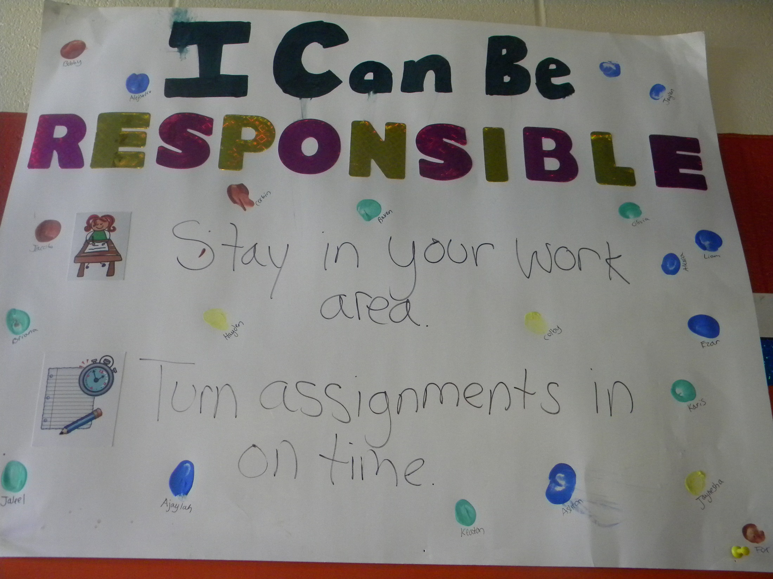
Notes:
Example

Slide 36
Tell
Step 2:
Teach Students
Show
Assess
Practice
Notes:
Developing Classroom Rules is Not Sufficient. In order for students to follow rules:
Rules must be directly taught to students and
Students must be allowed to practice the behaviors associated with the rule.
You just identified classroom rules, now you want to make your classroom rules effective by teaching them. After the classroom rules have been defined, it is helpful to post them in the classroom in a prominent spot where you and your students can refer to them regularly and frequently. Posting is not enough. Just like we teach our behavioral expectations for different school settings, like cafeteria, bathrooms, and hallways, we need to teach classroom rules to ensure students know them.

Slide 37
Create a Behavioral Lesson Plan
Components of a Behavioral Lesson Plan
Tell | Tell me specifically how to do it
Show | Show me specifically how to do it
Do | Let me practice doing it and give me specific feedback on how well I did. Allow me to correct mistakes.
Review | Review the specific steps with me again.
Notes:
Handout:
Tell, Show, Do, Review Lesson Plan
One concern teachers may have is that they don’t have time to teach separate behavior lessons. These can be stand alone lessons or embedded within instruction.

Slide 38
Tell
Step 3:
Set up Practice for Students
Assess
Show
Practice
Notes:
Developing Classroom Rules is Not Sufficient. In order for students to follow rules:
Rules must be directly taught to students and
Students must be allowed to practice the behaviors associated with the rule.
Once all our classroom rules have been identified, it is equally important that the rules we want students to demonstrate are systematically taught. This means there needs to be a plan for when and how classroom rules will be taught to students.

Slide 39
Tell
Step 4:
Encourage the Appropriate Behavior
Show
Assess
Practice
Specific Feedback Module
Notes:
Developing Classroom Rules is Not Sufficient. In order for students to follow rules:
Rules must be directly taught to students and
Students must be allowed to practice the behaviors associated with the rule.
Students must get Specific Feedback on their skill use (See Specific Feedback Module)

Slide 40
Encouraging Positive Behavior

Slide 41
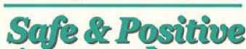

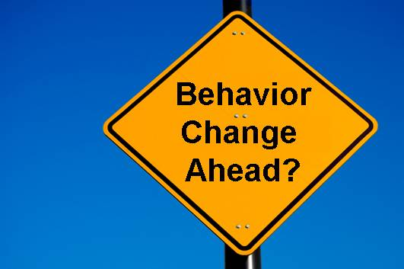
Understand the Power of Adult Attention
Notes:
One of the outcomes that teachers should seek in their classrooms is a positive climate of environment. Encouraging expected behavior is crucial to help students learn desired classroom behaviors and to shift the focus from addressing misbehavior to responding with positive attention for expected social behavior. Teacher attention has a powerful influence on the behavior of students and positive attention helps create a positive and safe classroom learning environment. The teacher helps set the tone or mood of the classroom through relationships with students and frequently recognizing students’ efforts to academic and behavioral goals.
Encouraging students to display expected classroom behavior is important because….
It helps to creates a safe and positive learning environment.
It motivates students to use the behaviors we have taught. Defining and teaching classroom expectations alone are not sufficient. We must also encourage student use of those behaviors. To help students continue to use the classroom expectations we have established, we followed the desired behavior with adult reinforcing behavior (positive feedback).
The encouragement motivates students as they are initially learning expected behavior, and maintains those behaviors as students become more fluent with use. We know how important it is to encourage students who are starting to learn new academic skills and the same is true with social behavior. Encouraging helps students when they are learning our classroom expectations and helps students maintain use of classroom expectations over time.
Encouragement is essential to changing student behavior.

Slide 42

Understand How it Works
A–B–C
Notes:
One of the researched tenets that is basic to schoolwide positive behavior support is that a positive consequence will positively impact the future occurrence of the behavior. In other words, if we give a positive comment or activity after a behavior we are increasing the likelihood the behavior will take place again in the future. If we thank students for raising their hand in a group discussion, we are highlighting that they did what we expect them to do and increase the likelihood students will raise their hand in the future.

Slide 43
A–B–C
Antecedent | Behavior | Consequence
Conditions or circumstances that alter the probability of a behavior occurring. | An observable act. What the student does. The actions or reactions to the antecedents. | The resulting event or outcome that occurs immediately following the behavior. Impacts future occurrence of the behavior.

Slide 44
A–B–C
Classroom Example:
Antecedent | Behavior | Consequence
Classroom Rules and Routines defined and explicitly taught. Teacher uses prompts/pre-corrects to remind students to follow rules, procedures. Teacher engages in active supervision as students follow rules, procedures | Students follow rules or procedures as taught. | Teacher observes the students following the rules or a routine and says for example in response to students following arrival procedure, “Great job coming into the classroom with quiet voices, putting your belongings away and going directly to your seat and following the directions on the board. You are showing responsible behavior.”
Notes:
Antecedent - When you develop clear and well-defined expectations for behavior (school wide expectations aligned with classroom rules and routines) and have taught those expectations to fluency, you have set the stage and created the antecedents so that students are more likely to choose to demonstrate appropriate behavior.
Consequence – When you respond to appropriate expected behaviors with a reinforcing consequence (the resulting event or outcome that occurs immediately following the behavior), it impacts future occurrence of the behavior. Once effect is an increases in the likelihood the behavior will recur in the future.

Slide 45
Activity: Encouraging Expected Behavior
Think and Share
Appoint a recorder for the whole group.
Take one minute and individually think of ways you and your school reinforce academic behavior.
Now, think of ways you and your school recognize social behavior.
What do you notice?
Notes:
Write down or think about how you and your school reinforce academic behavior. Have 1-2 volunteers share aloud. Now think about ways you reinforce social behavior. Are there as many?
Conclusion: We are accustomed to encouraging students for academic behavior and we want to be sure we give adequate attention for social behavior we expect in our classrooms.

Slide 46


Understand the Types of Adult Attention
Non-Contingent Attention:
Contingent
Notes:
There are two types of adult attention and both have a positive impact on interactions in schools.
Non-contingent Attention
Contingent Attention

Slide 47
Non-Contingent Attention:
Notes:
Non-contingent attention is attention provided regardless of how the student performs. Non-contingent attention:
Provides time and attention that is not tied to performance.
Helps fulfill students’ need to be noticed and valued.
Sufficient non-contingent attention may decrease frequency of attention-seeking misbehavior.
Provides role-model of positive social interactions.
Antecedents that help establish positive relationships between staff and students and set the stage for students to display desired academic and behavioral expectations and receive correction when needed.
Given that many instances of inappropriate behavior is based in a desire for attention, if we provide sufficient non-contingent attention, the frequency of behavior problems may decrease. As teachers report that positive student-teacher interactions increase, the number of disciplinary referrals students receive decreases. Also, as students report an increase of positive quality in the student-teacher relationship, a decrease in the number of behavior referrals they receive and an increase in the amount of time they spent on task (Decker, Dona & Christensen 2007).

Slide 48
Examples of Non-Contingent Attention – Preferred Adult Behaviors
  Proximity
  Listening
  Eye Contact
  Pleasant Voice
  Smiles
  Touch
  Use of Student’s Name
  Showing interest in student
  Greeting students at door
Notes:
Related to teacher attention is the student-teacher relationship and preferred adult behaviors that increase a positive student-teacher relationship. There is a growing body of research that indicates academic achievement and students’ behavior are both influenced by the quality of teacher-student relationship (Jones & Jones, 1998 and Algozzine, Wang & Violette, 2010). When students are asked what makes a teacher special and worthy of respect, students consistently cite three characteristics: firmness, compassion and an interesting, engaging and challenging teaching style (Noguera, 1995). These teachers are “intentionally inviting” and their professional attitude depicts their view of students as able, valuable and responsible.
Adult behaviors that impact student affect, compliance, and learning:
Proximity –communicate privately at 20” with individual students; communication across the room reserved for information intended for entire group only
Listening –pause, attend thoughtfully to the student
Eye Contact –communicate at eye level; look student in the eye when instructing or directing; hold eye contact briefly for compliance
Pleasant Voice –use calm pleasant voice when talking with, praising, and correcting students
Smiles –pleasant facial expression and frequent smiles
Touch –appropriate brief nurturing touch
Use of Student’s Name –begin interactions with student name and use frequently during interactions
Showing interest in student – bringing up topics of interest to student, talking about what you have discussed previously, asking about outside activities, etc.
Greeting students at door - greeting students as they enter your classroom has many benefits:
Allows teacher to greet each and every student to set the tone for the day/class
Models appropriate social behavior
Allows teacher to take care of any misbehaviors outside the classroom before a student enters the class.
Allows the teacher to assess the “mood” of each student as they enter the classroom, allowing an opportunity to mitigate any negative moods
Allows for pre-corrects for students who need them.
Not only do these adult behaviors (non-contingent attention) impact relationships, but they also set the stage for effectively interacting with students and delivering feedback (contingent attention).

Slide 49
Contingent Attention:
Notes:
Contingent attention is provided based upon student performance of an identified expectation or behavior. With contingent attention, the student must perform the expected behavior before the teacher responds with attention.
Contingent attention has been proven to:
Increases academic performance (Good, et al. 1981).
Increases on-task behavior (Sutherland, Wehby, & Copeland, 2000)
Increases likelihood students will continue to use the desired behavior in the future.
Helps students to discern correct or “right” responses from incorrect or “wrong.”
“You get what you pay attention to.”

Slide 50
Examples of Contingent Attention
    Praise
    Positive feedback
    Reinforcement
    Tangible item
Notes:
Although there is no universal reinforcers that will increase the likelihood that all students will repeat the appropriate skills in the future, adult attention is reinforcing for most students, especially when adults have previously built a positive relationship with them.

Slide 51

Use Specific Positive Feedback
Notes:
Preferred adult behaviors and non-contingent attention are not sufficient to change and sustain behavior. Specific positive feedback, one form of contingent attention, is essential.
Positive feedback is verbal reinforcement that is a form of social reinforcement that provides information on successful behavior while reinforcing or increasing the likelihood that behavior will be repeated. The term verbal praise is often used interchangeably with positive feedback.

Slide 52

Know the Importance of Specific Positive Feedback
Notes:
With specific positive feedback you are recognizing attainment of specified performance criteria, effort or successes at tasks that are difficult for a student. To ensure continued, specific positive feedback is crucial. Specific positive feedback is important:
Specific positive feedback is essential to change and sustain behavior. All people need positive feedback about their performance of a skill or behavior to learn the behavior. For example, if we ask a student “What is 4 + 4?” and the student says, “8” we give the student positive feedback to help the student know his answer was correct. That’s how s/he will learn that 4 + 4 = 8.
Specific positive feedback is used to recognize efforts or successes at tasks that are difficult for the student. If we give students positive feedback for their effort when tasks are difficult, it will encourage students to persist. Sometimes we need to give positive feedback when students display expected behavior for a short time.
While general praise contributes to a pleasant classroom, it is insufficient to build and sustain desired behavior. “Good job” is a phrase we hear staff say to students but general praise needs to be more specific to help students learn academic and social behavior, so they know exactly what behavior to repeat.
Positive feedback can be used to provide students clear specific feedback on classroom expectations.

Slide 53
Understand the Steps to Specific Positive Feedback
Step 1
Specifically Describe the Behavior
Step 2
Provide a Rationale
Step 3
Can include a Positive Consequence
Notes:
There are 3 things to keep in mind to make positive feedback effective to change behavior.

Slide 54
Step 1
Specifically Describe the Behavior
Specifically describe the behavior:
  Explicitly define what was done that you want to continue.
  Like a video-tape replay.
  Expressed using the words of classroom
  expectations/rules.
  Example: “When I said it was time to begin, you
  cleared off your desk, got your materials
  out immediately, and began working
  quickly.”
Notes:
First, teachers need to specifically describe the behavior. This helps students understand the exact behavior you want the student to continue. Think of a video-tape replay, we need to simply describe what we saw the student do and tie it to classroom or school-wide expectations/character trait/rules.

Slide 55
Step 2
Provide a Rationale
Provide a rationale:
  Explain the reason why the behavior is important.
  Teach the benefits of the behavior and the impact it has on them and others.
  Typically includes stating the classroom expectation and what the student might expect could happen if they use the appropriate behavior.
Example: “Getting started right away shows
cooperation, and you will likely have
less homework.”
Notes:
The second important thing to remember is that to make positive feedback effective is to provide a rationale which means explaining the reason why the behavior is important. Rationales or reasons teach the students the benefits of their behavior and the impact it has on them and others.
This helps teach the benefits of the behavior and how it impacts them or others. See how this can help students become more intrinsically motivated? If you include the classroom or school-wide expectation or character trait, it provides consistent language for our kids.

Slide 56
Step 3
Can include a Positive Consequence
Can Include a Positive Consequence
    When behavior requires a great deal of effort, pairing verbal feedback with tangible or activity reinforcement may be helpful.
    When using a positive consequence, always pair with specific positive feedback.
    Promote ownership; student
    “earns,” teachers do not “give.”
“Because you got started so quickly, you have earned a Cardinal Card.”
Notes:
For many students, the specific positive feedback alone is sufficiently reinforcing to strengthen the behavior. However, for some students, and when a behavior requires a great deal of effort, pairing the verbal feedback with tangible or activity reinforcement may be helpful. When using a tangible item or preferred activity it is imperative that you also use the complete verbal praise so that students are aware of exactly what they did that has resulted in earning the consequence. It is not the consequence that changes the behavior so much as the awareness of what is being reinforced; the consequence merely provides additional incentive. You will want to say something like, “Because you walked so quietly in the hallway, you have earned a Cardinal Card.” Note that adults do not “give,” instead students “earn.” Careful use of these terms helps students to take ownership for their behaviors and teaches the link between appropriate behavior and positive outcomes.

Slide 57
Important Considerations for Positive Feedback
Positive Feedback should be:
Sincere and appropriate for student’s age.
Contingent – on desired behavior being presented.
Immediate – follows closely to the behavior that has been exhibited.
Frequent – when trying to build a new behavior or build fluency.
Intermittent – when maintaining appropriate behaviors.
Notes:
Important Considerations for Positive Feedback:
Sincere and Appropriate for the students’ age: Giving sincere and appropriate feedback for the students’ age is important for all students but especially when working with older students. You will need to find your own style to communicate sincere care and concern for the student. Use of a variety of phrases shows spontaneity and therefore credibility.
Contingent: Since students “earn” specific positive feedback and consequences, it is provided only when they have demonstrated the desired behavior.
Immediate: Specific positive feedback is best when it follows closely to the behavior so that students can connect what they did with the feedback they are receiving. The younger the student, the more important this is.
Frequent when trying to build a new behavior: When students are learning new skills or are practicing skills in which they are not fluent, provide feedback on a continuous schedule. This means that every time the student displays the desired behavior, they receive specific positive feedback.
Unpredictable or Intermittent to maintain behavior: Once the skill or behavior has been learned, you will can shift to use of general praise and occasional use of specific positive feedback. This intermittent use of specific positive feedback helps to maintain the behavior. WE must be careful not to omit all specific feedback as students may not sustain the skills that they have learned.
“When we focus our praise on positive actions, we support a sense of competence and autonomy that helps students develop real self-esteem.” – Davis (2007)

Slide 58
Teachers Should Strive for a Higher Ratio of Positive Attention to Corrections
1
4
Notes:
In spite of the evidence that both non-contingent and contingent attention can change the climate and learning conditions of the classroom, many teachers fail to take full advantage of these powerful tools.
4:1 Ratio. Another important point in building positive school-wide and classroom environments is to ensure that appropriate behavior receives much more attention (at a higher ratio) than inappropriate behavior. Reavis, Jenson, Kukic & Morgan (1993) recommend a ratio of 4:1; four comments in response to desired student behavior to one response to student misbehavior. Interactions with students are considered positive or negative based on the behavior of the student at the time the attention is given, not the demeanor of the teacher.
What the Research Says:
Research has shown that teachers positively respond to student academic performance much more frequently than student social behavior. Typical teacher approval statements for academic responses far outweighed those for social behavior across all grade levels, with highest rates for each type of approval occurring in second grade and tapering off dramatically after that.
In all grade levels, teachers re­sponded to correct academic perfor­mance (20.36 per hour average) more frequently than disapprovals (7.56 per hour average). On the other hand, statements of disapproval for social behavior (19.20 per hour) were always more frequent than approvals (1.52 per hour). This attention to misbehavior (corrections) inadvertently maintains or increases the misbehavior.
The good new is we can change this to help us improve the learning environment and teach and support student use of important social skills…which are important life skills.

Slide 59
“Using a reward system is not the same as bribing a student to behave appropriately. A bribe is some-thing offered or given a person in a position of trust to influence or corrupt that person’s views or con-duct. SW-PBS acknowledges and rewards students for following school-wide (and classroom) expectations and rules. Appropriate behavior is acknowledged after it occurs. Rewards are earned, not offered as payoff in exchange for good behavior.”
Florida PBS

Slide 60
Build a Menu of Reinforcers
Notes:
Now we are going to talk about creating a menu of reinforcers that will serve to motivate all students. Remember a reinforcement is a consequence that happens after a behavior that increases the likelihood the behavior will occur again in the future. It is an important concept as we discuss ways to encourage students as they learn new social and academic skills.
What is a Menu of Reinforcers?
A variety of types of reinforcers (activities or privileges, social attention, tangible items)
A variety of schedules for earning (continuous or intermittent)

Slide 61
Why Build a Menu of Reinforcers?
Notes:
Why build a menu of reinforcer?
Not all students are reinforced by the same things or in the same ways.
Some students desire or seek social attention.
Others do not like or avoid social attention.
Include social attention, activities, and tangible items to appeal to all student needs.
Students learning new behaviors need a continuous schedule of reinforcement.
Students who have demonstrated mastery respond to an intermittent schedule of reinforcement.

Slide 62
Clarify and Teach Expectations – Define Expectations, Rules and Procedures, Teach and Actively Supervise
Encourage Expected Behaviors - Noncontingent Attention, Positive Feedback, Tangible Reinforcers
Discourage Misbehaviors – Correcting Social Errors
4
1
Notes:
Remember that you will get the greatest “bang for your buck” by making sure that
your expectations, rules and procedures are well defined and overtly taught to your students
you actively supervise your students at all times and
that you establish relationships with your students and acknowledge their appropriate behavior with positive feedback and tangible reinforcers if needed before applying corrections for social errors.
We have a tendency to over-rely on correction, which may interrupt or stop the misbehavior temporarily but typically does not change on-going misbehavior.

Slide 63

Understand the Power of Correcting Social Errors
Notes:
Consistently correcting social errors in a consistent and calm way has many benefits:
Upholds the importance of expectations.
Restores order to the learning environment.
Interrupts the inappropriate behavior, preventing practice of that behavior.
Capitalizes on the teachable moment.
Gives the child a chance to learn to be successful.
Increases probability of future correct behavior.
Decreases future time out of learning/instruction.
Demonstrates care and concern by the adult.
Builds relationships with students.
Maintains a positive learning climate.

Slide 64
“Teachers should focus on increasing positive behavior and interactions by consistently enforcing expectations.” Shores, Gunter & Jack, 1993
“When teachers are inconsistent in their enforcement of expectations, students become uncertain of what those expectations are and that the expectations apply to them.”
Evertson, Emmer & Worsham, 2003
“Clearly stating expectations and consistently enforcing them lends credibility to a teacher’s authority.”
Good & Brophy, 2000
Teachers who respond consistently feel positive about their teaching and help students improve their performance.
Freiberg, Stein & Huan, 1995
Notes:
It is extremely important that you enforce what you have taught your students. Consistency is important! If expectations are not consistently upheld, they are meaningless. You need to be consistent in enforcing your classroom and the schoolwide expectations and procedures. In addition, having a consistent response will help you feel better about your ability to handle misbehavior and helps students know that you are going to respond every time the misbehavior takes place, in the same calm way.

Slide 65
Activity: Personal Reflection Example
Challenging Activity and Misbehavior: Beginning of class students walk around, talk out
Specific classroom expectation or procedure: Sit in seat, read warm-up activity on Smart Board, begin to work on warm-up activity with voices off.
Effective Positive Feedback you will say: “Thanks for getting to work right away with your voice off. That helps you focus and take responsibility for your learning.”
Write the specific day and time you are going to give the Effective Positive Feedback. Tomorrow, first hour!
Notes:
Handout:
Positive Feedback – Increasing Appropriate Behavior

Slide 66
Responding to Problem Behavior
Responses vs. Punishments

Slide 67
Identify the need
Think of 1 student who has displayed inappropriate behavior this week.
  How did you respond?
  How did the student respond?
  Do you continue to see the behavior occur?

Slide 68
Re-Thinking Consequences
In traditional discipline, the word consequence is often used to describe a punishment.
A consequence is any thing that occurs after a problem behavior has occurred (positive or negative).
Effective consequences, or responses to behavior, are those that result in the problem behavior changing over time.
Ineffective consequences are those that may stop the behavior temporarily, but result in either no change or increase of the problem behavior over time.
Notes:
Key Points:
Traditional consequences are designed to be averse enough that the student will not want to repeat the behavior
Creating changes in behavior require understanding the behavior and modifying the environment and adult responses. Change takes time
Even though traditional consequences may stop a behavior temporarily (like ISS) upon analysis it is common that the same students are consistently repeating the same behaviors, which by definition makes that consequence ineffective (change over time is not occurring)

Slide 69
The ABCs
Understanding the purpose of behavior comes from repeated observation of:
  A: Antecedent: stimulus before the behavior
  B: Behavior: observable and measurable act
  C: Consequence: what occurs after the behavior that serves to maintain or increase frequency of behavior
Notes:
Key Points not Included on the Slide:
Creating changes in behavior require understanding the antecedent, the behavior, and the consequence.
Behaviors are signaled by an event in the environment, or antecedent, and are reinforced by consequences.
What prompts the behavior?
What does the behavior look like and sound like?
What occurs after the behavior to reinforce it? Does it work to get what the child wants?
Behavior can be predicted.

Slide 70
Consequences
Consequences are:
  The outcome of the behavior
  The responses of adults and/or peers to the behavior
Responses that reinforce behavior lead to repetition of the behavior.
Notes:
Handouts and Activities: HANDOUT 2: Effect of Consequence on Behavior
Key Points not Included on the Slide:
To better understand consequences think about: what usually happens after the behavior occurs? What is the typical adult/peer response?
It is not what we “do to kids” so they will be miserable.
Behaviors are repeated when desired outcomes are achieved. This is true for both desired and undesired behaviors.
If you desire to lose weight, and you do so after changing your eating and exercising, you are likely to continue.
If be outcomes are undesired, the behaviors won’t be repeated. If you desire to lose weight, and you don’t loose weight after changing your eating and increasing exercising, you will go back to eating donuts. ☺
Frequent teacher attention in the form of
praise is more
effective than rules or reprimands
in increasing
appropriate behavior.

Slide 71
Consequences
To understand the consequences of a behavior, observe what happens in the environment immediately after the behavior.
  What is the pay-off?
  What does the student get?
  What does the student avoid?
Notes:
Key Points not Included on the Slide:
A consequence is what occurs following the behavior
Do consequences support the problem behavior causing it to reoccur?
Think of the answers to the questions in order to determine what consequences are supporting the behavior.
Once you know this you can begin to alter consequences to support only desired behaviors and to ensure that consequences don’t actually support problem behavior.

Slide 72
ABC: Revisit this situation
Think of 1 student who has displayed inappropriate behavior this week.
  What was the antecedent?
  What was the specific behavior?
  What was the maintaining consequence?

Slide 73
Prevent/Teach/Respond
Problem behavior cannot be changed by the responses alone, because those only occur after the problem behavior and the possibility for intervention is reduced.
Effective classroom managers should focus first on strategies designed to prevent and modify behavior before it occurs.
  Prevention through routines and procedures
  Replacement through teaching expectations
  Reinforcement of desired behavior through positive responses
  Effective, logical responses to problem behaviors
Notes:
Key Points:
When simply focusing on consequences, you reduce 70% of options you had for changing problem behavior
Behavior is usually demonstrated in a repeating pattern. This is an advantage because it gives us ample opportunities to modify things in advance and prevent the pattern from repeating itself.
Focusing solely on what to do after the problem has occurred is missing most of the opportunities for change. Prevention must always be the main focus

Slide 74
Let’s Compare/contrast the similarities between responses to Academic and Social errors
Academic
Social Behavioral
Identify error
Re-teach correct response
Model/demonstrate
Provide guided practice & feedback
Provide independent practice
Monitor
Provide feedback
Identify the error
Re-teach expected behavior
Model/demonstrate
Practice
Monitor
Provide encouragement
Correct and re-teach as needed
Notes:
One place to start when we think about ways to respond to social errors is to look at how we respond to academic errors.

Slide 75
Teacher Corrective Response
A–B–C
Classroom Example:
Antecedent | Behavior | Consequence
Classroom Rules and Routines defined and explicitly taught. Teacher uses prompts/pre-corrects to remind students to follow rules, procedures. Teacher engages in active supervision as students follow rules, procedures | Students do not follow rules or procedures as taught. | Teacher observes the students not following the rules or a routine, e.g. arrival procedure and responds with a re-direction and re-teaching, “Class remember you need to be responsible by coming into the classroom with quiet voices, putting your belongings away and going directly to your seat and following the directions on the board. Everyone line up and we will practice by entering the classroom again.”
Notes:
The Teacher
Identifies the behavior error
Re-directs and Re-teaches the expected behavior
Models/demonstrates the behavior
Has the students practice

Slide 76
Classroom Example:
Prevention
A–B–C
Specific Praise
Antecedent | Behavior | Consequence
Teacher responds with re-direction and re-teaching, “Class remember you need to be responsible by coming into the classroom with quiet voices, putting your belongings away and going directly to your seat and following the directions on the board. Everyone line up and we will practice by entering the classroom again.” | Students follow entering the classroom procedures as taught. | Teacher observes the students entering the classroom following the arrival procedure, “Great job coming into the classroom with quiet voices, putting your belongings away and going directly to your seat and following the directions on the board. You are showing responsible behavior.”
Notes:
The Teacher (cont.)
Monitors the practice
Provides encouragement (specific praise)
Corrects and re-teaches as needed

Slide 77
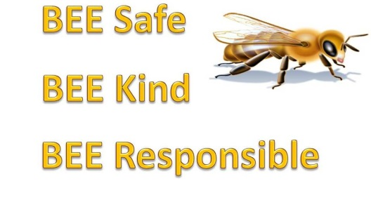
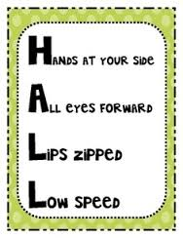
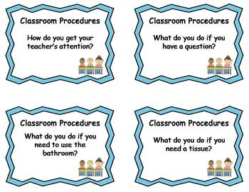

Understand When to Respond to Staff Managed Misbehavior
Respond to Violations of:
School-wide
Expectations
Non-classroom Procedures
Classroom
Expectations or Procedures
Any Other Social Skill
Notes:
All staff are expected to manage any inappropriate behavior that runs counter to your expectations and is not listed as office-managed. This includes any or all behavior that runs counter to:
School-wide expectations
Non-classroom procedures
Classroom expectations or procedures
Any other socials skills you have adopted
While “staff-managed” behaviors are called “minor” behaviors, it is essential that they not be over­looked and that staff address and correct these behaviors, just as they would an academic error. Minor behaviors left unaddressed have a way of continuing, worsening and spreading.

Slide 78


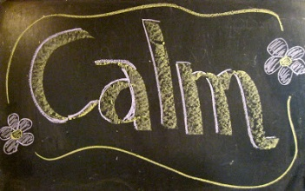


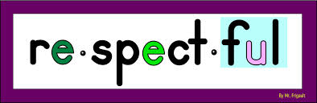

Consider Some General Concepts for Effective Teacher Responses to Staff Managed Misbehavior
Active Supervision
The Class
Notes:
General Considerations:
Consistency. Misbehavior occurs in all school settings and therefore, all staff need to respond reliably. When we consistently uphold our expectations, limit-testing behavior is diminished and fewer incidents of correction need to occur. It is less important what the response is, than that something is consistently done when student behavior does not reflect the standard. Consistency is the key to changing behavior.
Active supervision. Madeline Hunter used to say, “Inspect what you expect.” Effective teachers have eyes in the back of their heads and scan continuously for appropriate and inappropriate behavior. When teachers use prompts, it not only sets students up for success but also reminds the teacher to watch for the desired behaviors across the school day.
A calm immediate response. The disruptive influence of the teacher’s response should be no greater than the disruption of the student. Angry responses by staff create tension and increase the likelihood of disobedience and disruptive behavior. A calm immediate response has a positive effect. Use a professional and composed voice tone and volume.
Specific, yet brief. Specific descriptions of the behavior and expectations help students to know exactly what is expected. With specific descriptions, you are using the inappropriate behavior as an incidental teaching opportunity. While specificity is essential to change behavior, brevity is also important. Lectures often turn into scolding and do not hold the child’s attention. Be short and concise, and then disengage quickly.
Quiet, respectful contact with the student. First, make quiet contact with the student, securing their attention. Talk with them in close proximity to ensure privacy and respect. Use their name, pleasant voice tone, and eye contact to covey your interest in them personally and your desire to help them to be successful. A private, quiet, personal contact will help with compliance as well as relationships.
Refocus class if needed. If the inappropriate behavior will require a bit of time, refocus the attention of the class to allow you to deal privately with the student. Most correction strategies can be handled within the classroom or setting, just as you would correct academic behavior. Your intent, demeanor, and voice tone do not differ from academic correction and the interaction should be able to occur within the classroom while still maintaining respect for the student and the learning of the entire class.

Slide 79

Preplan and Become Fluent in Your Responses to Student Misbehavior
Corrective
Consequences
Direct
Error Correction
Actions
to Minimize
Notes:
Teachers can maximize the effectiveness of their responses to student misbehavior by becoming skillful at preplanned responses for those misbehaviors that require a teacher response. Preplanning allows you to think through you options so you won’t be caught not knowing what to do or how to respond. Because it is not possible to preplan for every potential misbehavior in your classroom, you must build a repertoire of teacher responses.
It is also helpful to consider responses to misbehavior as a layering of responses depending on the situation and the student(s). Responding to misbehavior can begin with simple responses with the addition of more time consuming responses as needed. These responses can be thought of in three categories:
Actions to Minimize
Direct Error Correction
Corrective Consequences

Slide 80
Use
Actions to Minimize Misbehavior
Before it Gets Out of Hand
Corrective
Consequences
Direct
Error Correction
Actions
to Minimize
Notes:
There are some simple strategies used by many teachers to respond swiftly to minor misbehavior that are carried out quickly and are unobtrusive to instruction:
Pre-correction
Proximity Management
Non-verbal cues
Ignore, Attend, Praise

Slide 81
Provide Direct Error Correction: if the simple techniques do not work
Corrective
Consequences
Direct
Error Correction
Actions
to Minimize
Notes:
If the simple techniques discussed earlier do not result in the desired change in behavior, more direct instructional approaches can be used. With staff-managed behaviors, all are expected to seize every opportunity to establish appropriate student behavior. While there are many strategies for dealing with misbehavior, the following four strategies provide a full yet doable continuum of instructionally based approaches for error correction strategies for inappropriate behaviors that continue or do not respond to simple management techniques:
Re-direct
Re-teach
Guided Self-direction
Provide Choice
Student Conference

Slide 82
Layer by Adding Corrective Consequences As Necessary
Corrective
Consequences
Direct
Error Correction
Actions
to Minimize
Notes:
Corrective consequences are effective teacher responses to misbehavior that are added (layered) to direct error correction when needed. These corrective consequences can also be “logical” which can make the teacher response more powerful. When using corrective consequences you must first become comfortable and fluent with delivering these strategies, i.e. correcting style. Next, you must determine for which misbehaviors these corrective consequences are logical if possible. For example, “positive practice” of walking in the hallway is a logical consequence for running in the hallway. Restitution: cleaning up the environment in which you mad e a mess, Think sheet, etc.

Slide 83

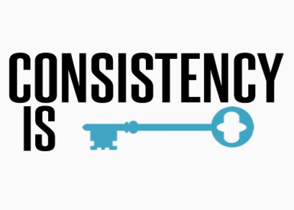

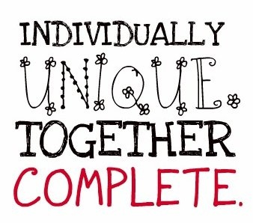


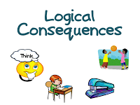
Understand the Use of Consequences
(Teacher Responses to Misbehavior)
Some Consequences are Ineffective
Notes:
Consequences are not punitive: Consequences paired with teaching of the alternative or desirable behavior can heighten behavior change. Effective consequences result in greater learning and often involve learning tasks or opportunities directly related to the inappropriate behavior. In this manner, they are similar to what we do when students are not making academic progress. We find additional practice or activities to help them learn and grow. Role-play or practice, reflecting on the behavior and the alterative, arranging a situation for the student to demonstrate the skill, and making amends for behavior that impacted others are all wonderful learning-based consequences. Effective consequences maintain student dignity and invite the student to take re­sponsibility for his/her behavior and be a part of the solution. Even though consequences can be educational, they are also mildly aversive. That is they require effort and should leave little incentive to repeat the inappropriate behavior. They need not be merely punitive.
Consistency, not size is important : It is not the size of the consequence that promotes behavior change, but the certainty that something will be done. This is a common misunderstanding as educators often look for a bigger consequence–that big one that will stop the behavior. It is not, however the severity of the consequence but the inevitability that a response will occur that promotes change.
Consequences should be selected individually: Consequences are best when they are selected to fit the individual child, the specific behavior and setting, the frequency, and the severity of the behavior. What fits one may not fit another. The best consequences are selected to match the individual learner’s needs.
Warning systems can promote chronic misbehavior: - Some inadvertently believe that warning systems (e.g., three strikes and you’re out, flipping cards, etc.) demonstrate fairness. In fact, warning systems can promote sneakiness or continued effort to try to get away with the behavior or as a way to gain the attention of the teacher and distract the teaching process. With a continuum of strategies, we are better to immediately and swiftly use the least intrusive consequence for the frequency or severity of the behavior and increase our teaching efforts and use of instructionally based consequences as needed for subsequent occurrences. Warning systems alone can be discouraging to students. Students who struggle with social behavioral issues may perceive that they can’t meet the goals or expectations and therefore give up. Warning systems may actually increase the likelihood of inappropriate behavior rather than reduce it.
Logical consequences are often more effective: - A logical conse­quence is one that is a logical outcome of the student’s behavior, allowing the behavior and consequence to be eas­ily linked in the student’s mind. These consequences are often the result of situational contingencies (e.g., since you did not finish your work in class you will have homework; since we did not transition from one activity to an­other quickly, we will be delayed in getting our work done and will be late to _____; since you were running in the hall you will need to return and walk; since you offended Ms. Jones, you will need to find a way to re-build the rela­tionship, etc.) Developing a menu or continuum of consequences specific to each non-classroom area or for each classroom procedure will help you to avoid generic or illogical consequences such as the removal of recess or detentions, which tend to be over­used in many schools, while allowing you to use instructionally relevant and logical consequences.
SOME CONSEQUENCES ARE INEFFECTIVE. If a teacher notices they are repeatedly using a consequence for the same behavior and the consequence is not changing the behavior, then it’s likely that its time to employ a different consequence. This is an example of that old saying, “If you do what you’ve always done, you’re likely to get what you’ve always gotten.” This could be a good time to work with your colleagues to come up with other strategies or consequences to try.

Slide 84
Summary: Responding to Student Misbehavior
Address misbehavior consistently and quickly, while still early.
Use the strategy that is the least intrusive yet still appropriate for the frequency or severity of behavior.
If efforts to re-teach are not resulting in behavior change, consider including an additional consequence.

Slide 85
SWPBS in the Classroom
Tell
Routines & Procedures
Expectations & Rules
Encouraging Positive Behavior
Discouraging Problem Behavior
Assess
Show
Practice
Notes:
Implementing these four components into your classroom will increase the amount of academic learning time available. SWPBS and in the classroom creates a strong support system for all students and teachers.

Slide 86
Turn & Talk
How can establishing routines and procedures prevent inappropriate behavior?
How can defining expectations and rules prevent inappropriate behavior?
How can you encourage positive behavior?
What is one way to discourage inappropriate behavior?

Slide 87
Questions & Discussion?

Slide 88
References
Algozzine, B., Wang, C., & Violette, A.S. (2010). Reexamining the Relationship Between Academic Achievement and Social Behavior. Journal of Positive Behavior Interventions 13(1), 3-16.
Decker, D.M., Dona, D.P., & Christenson, S.L. (2007). Behaviorally at-risk African American students: The importance of student–teacher relationships for student outcomes. Journal of School Psychology 45, 83–109
Good, C.E., Eller, B.F., Spangler, R.S., & Stone, J.E. (1981). The effect of an operant intervention program on attending and other academic behavior with emotionally disturbed children. Journal of Instructional Psychology, 9(1), 25-33.
Jones, V.F., & Jones, L.S. (1995). Comprehensive classroom management. Boston: Allyn and Bacon.
Lane, K.L., Kalberg, J.R. & Menzies, H.M. (2009). Developing schoolwide programs to prevent and manage problem behaviors: A step-by-step approach. New York: Guilford.
Reavis, Jenson, Kukic & Morgan (1993). Utah's BEST project: Behavioral and educational strategies for teachers. Utah State Office of Education, Salt Lake City, UT.
Sutherland, K.S., Wehby, J.H. & Copeland, S.R. (2000). Effect of varying rates of behavior-specific praise on the on-task behavior of students with EBD. Journal of Emotional and Behavior Disorders, 8, 2-8.

Slide 89
Brophy, J. & Evertson, C. (1976). Learning from teaching: A developmental perspective. Boston, MA: Allyn and Bacon.
Brophy, J. (1998). Motivating Students to Learn. Boston: McGraw Hill.
Evertson, C., & Emmer, E. (1982). Preventive classroom management. In D. Duke (Ed.), Helping teachers manage classrooms. Alexandria, VA: Association for Supervision and Curriculum Development.
Evertson, C. M., Emmer, E. T. & Worsham, M.E. (2003). Classroom Management for Elementary Teachers. Boston: Pearson Education.
Freiberg, J., Stein, T., & Huan, S. (1995). Effects of a classroom management intervention on student achievement in inner-city elementary schools. Educational Research and Evaluation, 1, 36-66.
Good, T. & Brophy, J. (2000). Look Into Classrooms. Boston: Allyn & Bacon.
IRIS Center, Research to Practice Instructional Strategies. Nashville: Vanderbilt University.
Johnson, T.C., Stoner, G. & Green, S.K. (1996). Demonstrating the experimenting society model with classwide behavior management interventions. School Psychology Review, 25(2), 199-214.
Kern, L., Clemens, N.H. (2007). Antecedent strategies to promote appropriate classroom behavior. Psychology in the Schools, 44(1), 65-75.
Newcomer, L. (2007, 2008). Positive Behavior Support in the Classroom. Unpublished presentation.
Shores, R., Gunter, P., & Jack, S. (1993). Classroom management strategies: Are they setting events for coercion? Behavioral Disorders, 18, 92-102.
Simonsen, B., Fairbanks, S., Briesch, A., Myers, D. & Sugai, G. (2008). Evidence-based practices in classroom management: Considerations for Research to practice. Education and Treatment of Children, 31(3), pp. 351-380.

Slide 90
De Pry, R. L., & Sugai, G. (2002). The effect of active supervision and precorrection on minor behavioral incidents in a sixth grade general education classroom. Journal of Behavioral Education, 11(4), 255-267.
Lampi, A.R., Fenti, N. S., & Beaunae, C. (2005). Makin the three p’s easier: Praise proximity, and precorrection. Beyond Behavior, 15(1), 8-12.
Simonsen, B., Fairbanks, S., Briesch, A., Myers, D. & Sugai, G. (2008). Evidence-based practices in classroom management: Considerations for research to practice. Education and Treatment of Children, 31(3), pp. 351-380.
Sprick, R., Knight, J., Reinke, W. & McKale, T. (2006). Coaching classroom management: Strategies and tools for administrators and coaches. Eugene, OR: Pacific Northwest Publishing.

