Slide 1


Competitiveness in the Agribusiness Environment
(from analysis to cooperative strategy development - a South Africa case study)
1st Annual Lecture of the Cooperative Central Bank
University of Cyprus
22 Nov. 2016
Johan van Rooyen, Director &
Johann Boonzaaier, PhD student
Centre for Agribusiness
Stellenbosch University

Slide 2

GREETINGS FROM STELLENBOSH
UNIVERSITY, SOUTH AFRICA

Slide 3
My talk in a nut shell:
- Competitiveness is a necessary ingredient for agricultural existence in todays world……. If you want to manage it, you must measure & analyse it; otherwise it just remains a “good idea or theory”
The challenge:
- Designing a theoretically sound and systematic approach to measure and analyse competitive performance

Slide 4
Global Competitiveness measured and analysed

Slide 5
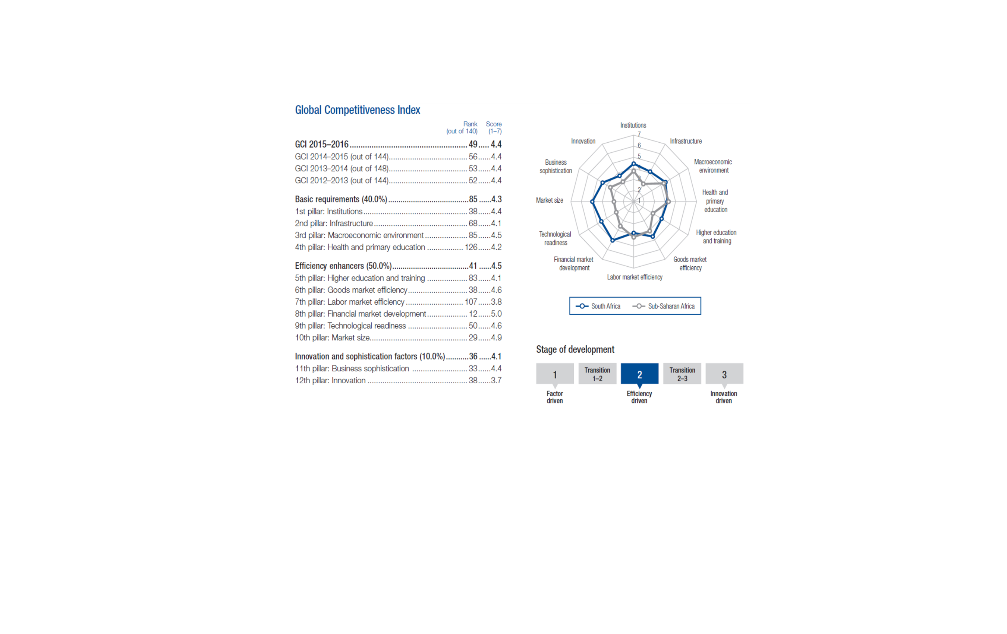


Slide 7
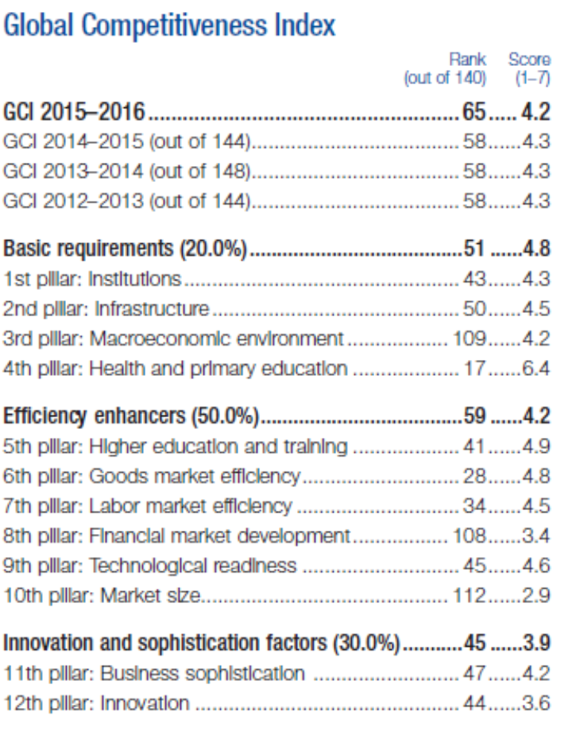
Cyprus Competitive Performance

Slide 8
Cyprus Competitiveness Index

Slide 9
Content & Scope
Theme: To translate COMPETITIVENESS THEORY in to a useful tool for STRATEGIC AGRIBUSINESS ANALYSIS and PLANNING:
Establish a theoretical framework of analyses
Consider and define the business context of an industry and measure competitive performance
Application to the SA Agricultural sector – 1961, 2005, 2008, 2016; ….some analysis on Cyprus too
Reference a number of Fruit Industry case studies; and
Propose future research and enquiry

Slide 10
Enquiry in to sector/industry/firm level competitiveness?
Comprehensive economy wide views available but not much industry level enquiry:
IMD – WORLD COMPETITIVENESS YEARBOOK
WEF - GLOBAL COMPETITIVENESS REPORT
Agri-focussed analysis? rather constrained views
Agri-benchmarking in fruit industry – O’Rourke, production cost based.
Marketing Decision Support Models (DSM) & Market Attractiveness Index (MAI)?
Profits; productivity; ROI; ROR, etc. ?

Slide 11
THE AGRI-COMPETITIVENESS ANALYSIS
PROGRAMME (ACAP)
Stellenbosch University
1. Approach and process:
New competitiveness theory framework
Participative analysis & planning - stakeholders/client inputs
2. Funding (in whose interest?):
Project based: Industry, banking sector (Standard Bank
AgriBusiness), government (Western Cape Dept of Agriculture),
agribusiness/commodity groupings
3. Dissemination:
Annual Agri-Competitiveness Seminar, publications, papers
4. Selected commodities:
30 value chain groupings; 1600 observations: Deciduous- citrus- stone fruit, wine, dates, grains, dairy, sugar, forestry, meat and game…

Slide 12
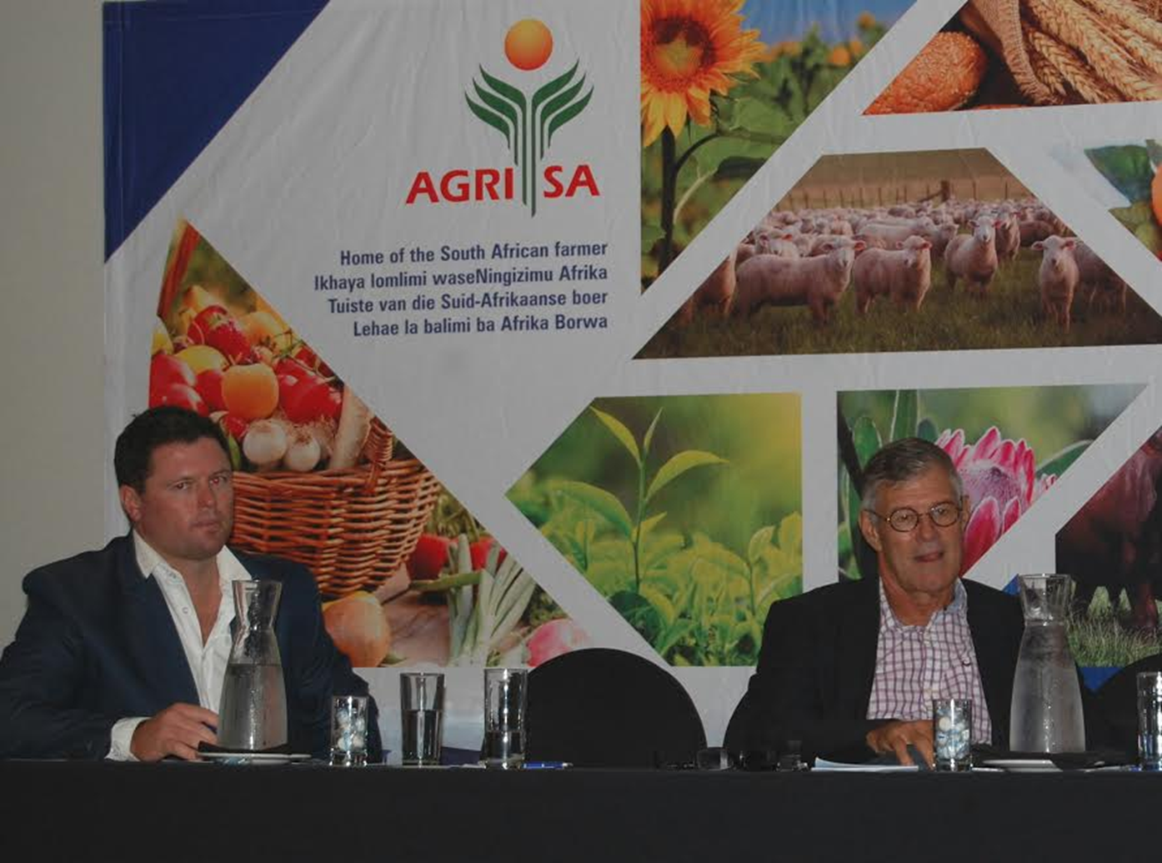

Slide 13
The theory of competitiveness: From Absolute Advantage (Adam Smith, 1776) to Competitive Advantage ( Porter, 1998)
Mercantilism; “strengthening the country” (1500-1800)
Classical Trade Theory:
- Absolute Advantage – wealth is created by natural endowments (Adam Smith, 1776)
- Comparative Advantage - specialisation theory (David Riccardo, 1817)
- Politics of Protection (J.S. Mill, 1873)
Neoclassical models:
- Factor Proportions Theory – TFP (Heckscher-Ohlin, 1919,1933)
- Factor Price Equalisation Theorem – (Samuelson, 1948)

Slide 14
Theoretical framework:
Challenges to Comparative Advantage:
- Leontief Paradox – opposing the H-O Theory ( V. Leontief, 1953)
- Wealth through Economies of Scale ( Krugman, 1979; Lancaster, 1979)
New Competitiveness Theory:
- Competitive Advantages – wealth through strategic
choices (Michael Porter, 1990;1998); and
applications:
- Nine Factor Model (Cho, 1994)
- Double Diamond Models ( Rugman & Cruz,1993;
Moon, Rugman &Verbeke,1995)
- WEF (Global Competitiveness Report); IMD (WCR)

Slide 15
National industry or sector researched | Authors or researchers | Proxies for measurements and/or models/frameworks applied | Verdicts or conclusions
The European agro-food system | ISMEA (1999) | RTA & Porter diamond model | Scope for European Commission/Union integration
Hungarian agricultural-food sectors | Fertő and Hubbard (2002) | RCA and RTA | Hungary has a comparative advantage for 11 of the 22 aggregated product groups.
Namibian table grape production | Thomas (2007) | Porter diamond model | The Namibian table grape chain is relatively competitive in the international arena. Primary production in becoming more competitive.
Livestock product exports from India | Kumar (2010) | Export and import analysis – nominal protection coefficient (NPC) | India is competitive in the export of meat products, except poultry.
China’s agricultural products | Qiang, Yong-Sheng and Xiao-Yuan (2011) | RCA and trade coefficient specialisation (TCS) | Ability of direct factors is strong in terms of transformation from cost advantage and price advantage into competition advantage.
Poultry production in the Czech Republic | Belová et al. (2012) | Trade-related comparisons – Lafay Index (LFI) | The comparative disadvantage deepens in relation to European Union countries.
Global Pear Market | Valenciano, Giancinti and Uribe (2012) | RCA | Geography plays a main role in competitiveness with nearby markets, as happens in markets with free trade.
Tobacco sub-sector in the Republic of Macedonia | Tuna, Georgiev and Nacka (2013) | RCA and Porter diamond model | The republic of Macedonia has favourable conditions and a competitive advantage for producing tobacco.
Canadian wheat, beef and pork sectors | Sarker and Ratnasena (2014) | RCA and normalised revealed comparative advantage (NRCA) | Canada has enjoyed international competitiveness in the wheat sector, but not in the pork sector, whilst the beef sector has grown rapidly since 1992.

Slide 16

ACAP approach to COMPETITIVE PERFORMANCE
ANALYSIS: A Five Step analytical framework
1. DEFINITION Contextualise and define agri-competitiveness
2. MEASUREMENT
3. IDENTIFY FACTORS
AND CLUSTER INTO
DETERMINANTS
4. ANALYSE
5. STRATEGY
PLANNING
Empirically measure competitive performance - IF YOU MEASURE YOU CAN MANAGE
Identify, through interviews with industry experts and knowledgeable stakeholders (Executive Survey), trends and major factors impacting on competitive performance
Establish the major Determinants of Competitiveness through the application of the “new” competitiveness theory (Porter, 1990)
Develop strategies to enhance the competitiveness of Agricultural Industries in SA –Participative planning (Log Frames…)

Slide 17

Step 1:DEFINING COMPETITIVE PERFORMANCE
“The ability of an industry/firm/sector to attract investment and other scares resources by trading products in the global market, whilst striving to earn at least the opportunity cost of resources engaged” (Freebairn, 1987)
Notions of:
- Sustained international trade
- Scarcity; opportunity cost;
- Trends – “understand the trends and you know
what is happening”

Slide 18
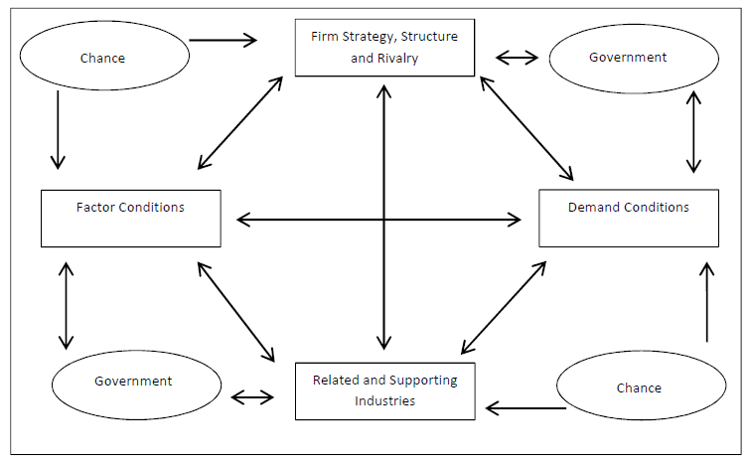
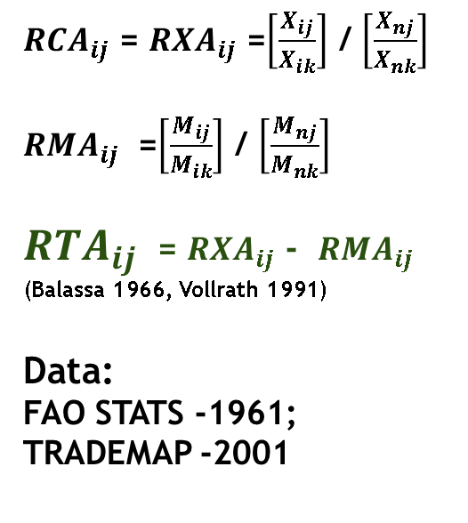
STEP 2: MEASUREMENT AND ANALYSES:
STRATEGIC ANALYSIS
& PLANNING
Cost Measures
Profitability
Productivity and Efficiency measures
PORTER DIAMOND;EXEC SURVEYS; FOCUS GROUPS
TRADE BASED MEASURES
RCA and RTA
Other Indices; EMS, NEI,
${RCA}_{ij}$ = ${RXA}_{ij}$ =$\left[\frac{X_{ij}}{X_{ik}}\right]$ / $\left[\frac{X_{nj}}{X_{nk}}\right]$
${RMA}_{ij}$ =$\left[\frac{M_{ij}}{M_{ik}}\right]$ / $\left[\frac{M_{nj}}{M_{nk}}\right]$
${RTA}_{ij}$ = ${RXA}_{ij}$ - ${RMA}_{ij}$
(Balassa 1966, Vollrath 1991)
Data:
FAO STATS -1961;
TRADEMAP -2001
Vollrath
(1991)
Porter
(1998)
Data & Info
COMPREHENSIVE ASSEMENTS

Slide 19
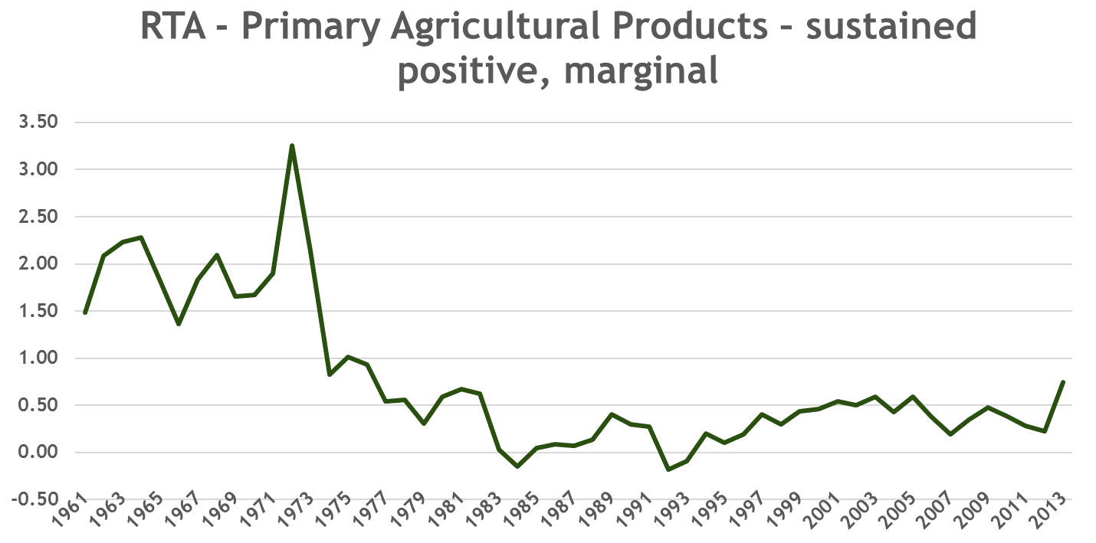
SA Agricultural competitiveness: long term trends (FAO Data)
War – economy;
Urbanisation
Sanctions economy
Low agric subsidies
Madiba Magic
+
Learning by doing
“no” agric subs
Droughts?
Sustaining
Global
Comp.
“low agric” subs
1st economic deregulation
Reduction in direct farm subs
Droughts?
Protectionism;
Subsidisation
of farming

Slide 20
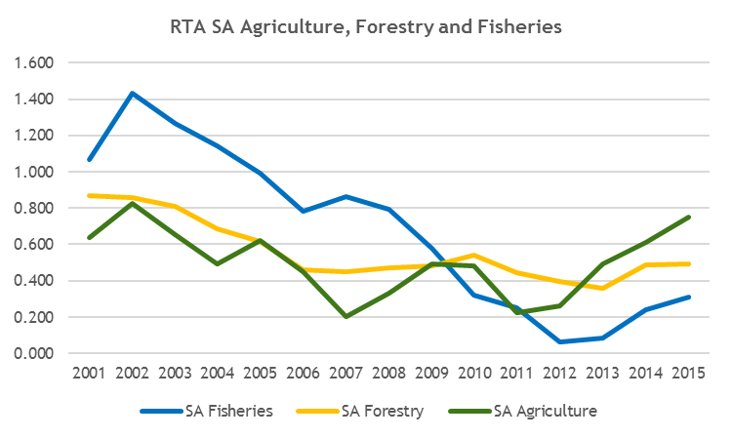
Industry RTA’s 2001 -2015 : Agriculture, Forestry and Fisheries (ITC Data)

Slide 21
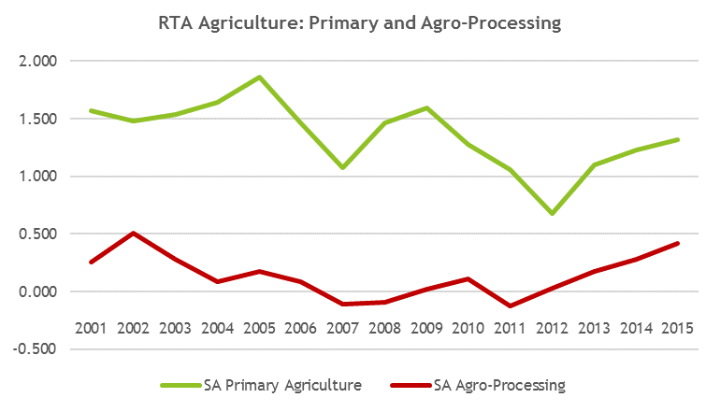
Industry RTA’s : Primary Agriculture
vs Agro-Processing (ITC Data)

Slide 22
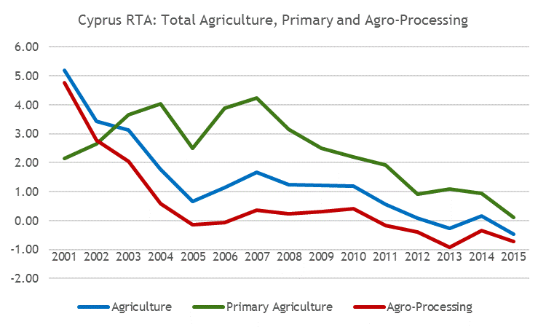
Cyprus Agricultural Industry RTA,
Primary and Agro-processing RTA’s (ITC Data)

Slide 23
RSA industry RTA’s : SA Grain value chains
Codes: Blue + yellow- marginal; red - negative
HS Code Product Description 2001 2002 2003 2004 2005 2006 2007 2008 2009 2010 2011 2012 2013 2014 2015
110313 | Maize (corn) groats and meal | 5.19 | 23.95 | 13.00 | 4.09 | 121.22 | 6.79 | 1.44 | 23.66 | 34.19 | 30.17 | 24.54 | 36.94 | 47.89 | 48.78 | 62.91
110220 | Maize (corn) flour | 6.56 | 24.36 | 6.01 | 2.82 | 15.86 | 2.59 | 4.31 | 11.83 | 10.18 | 13.69 | 11.20 | 8.61 | 11.48 | 14.20 | 10.81
110419 | Cereals, rolled or flaked grains nes | 0.56 | 0.29 | 0.23 | -0.57 | -0.02 | 0.40 | 0.88 | 0.86 | 0.07 | 0.57 | 1.15 | 2.89 | 1.92 | 1.55 | 4.13
110812 | Maize (corn) starch | 10.83 | 13.66 | 10.85 | 7.28 | 6.46 | 2.27 | 1.96 | 3.26 | 4.00 | 3.83 | 3.55 | 2.40 | 3.49 | 3.48 | 2.79
110320 | Pellets | 0.00 | 0.45 | 5.24 | 0.06 | 4.69 | 6.72 | 4.66 | 5.14 | 9.46 | 8.56 | 4.17 | 6.00 | 2.50 | 1.59 | 2.64
110319 | Cereal groats and meal nes | 36.39 | 1.83 | -2.97 | -4.47 | -9.50 | 0.10 | 0.17 | 0.27 | 0.53 | 6.12 | 4.55 | 5.69 | 5.00 | 1.18 | 2.29
110100 | Wheat or meslin flour | 2.39 | 3.32 | 1.57 | 0.96 | 0.47 | 0.43 | 0.12 | 0.36 | 1.28 | 2.11 | 1.62 | 2.22 | 2.35 | 1.62 | 2.11
110610 | Flour and meal of the dried leguminous vegetables of heading | 0.22 | -1.02 | -0.21 | -0.10 | 0.19 | 1.50 | -0.27 | -0.48 | -0.55 | 4.98 | 2.36 | 6.77 | 0.08 | 1.08 | 0.97
110819 | Starches nes | -0.15 | 0.13 | 0.37 | 0.16 | -0.04 | -0.05 | -0.06 | -0.60 | -0.11 | 1.76 | 0.80 | 1.16 | 0.94 | 0.60 | 0.54
110290 | Cereal flour nes | 6.13 | 1.34 | 0.40 | 0.53 | 0.99 | 0.64 | 0.18 | 0.46 | 0.77 | 1.87 | 3.03 | 2.66 | 0.85 | 0.94 | 0.46
110422 | Oats, hulled,pearled,sliced or kibbled | 0.04 | 0.11 | 0.10 | -0.21 | -2.07 | -1.60 | -0.08 | 1.73 | -3.40 | 0.05 | -0.06 | -0.26 | 1.16 | 0.17 | 0.43
110510 | Potato flour and meal | 2.02 | 1.27 | 0.57 | 0.42 | 0.80 | 0.32 | 1.72 | 0.23 | 2.09 | 0.47 | -12.45 | -16.70 | -17.23 | 0.32 | 0.30
110811 | Wheat, starch | -0.45 | -0.61 | -0.23 | -0.38 | -0.23 | 4.76 | 0.04 | -0.17 | -0.14 | 2.91 | 0.62 | 0.29 | 0.27 | 0.50 | 0.23
110429 | Cereals, hulled, pearled, sliced or kibbled nes | 0.02 | 0.19 | 0.09 | 0.05 | 0.03 | -0.89 | -2.30 | 0.14 | 0.40 | 1.92 | 0.51 | 0.27 | 0.39 | 0.11 | 0.14
110520 | Potato flakes | -0.85 | -0.82 | -0.64 | -0.85 | -0.79 | -0.68 | -1.10 | -0.52 | 0.13 | -0.06 | -0.05 | -0.46 | 0.29 | -0.17 | 0.02
110430 | Germ of cereals, whole, rolled, flaked or ground | 0.03 | 0.03 | 0.01 | 0.01 | 0.07 | 0.07 | 0.02 | -0.06 | -0.01 | -0.12 | 0.46 | 0.14 | 0.42 | 0.27 | 0.02
110210 | Rye flour | -0.61 | 2.60 | -2.07 | -4.18 | -4.74 | -4.28 | -1.71 | -1.76 | -2.72 | -1.12 | -1.03 | 0.00 | 0.00 | 0.00 | 0.00
110230 | Rice flour | -0.02 | 0.02 | -0.01 | -0.01 | 0.01 | -0.01 | 0.00 | 0.00 | 0.00 | 0.00 | 0.00 | 0.00 | 0.00 | 0.00 | 0.00

Slide 24
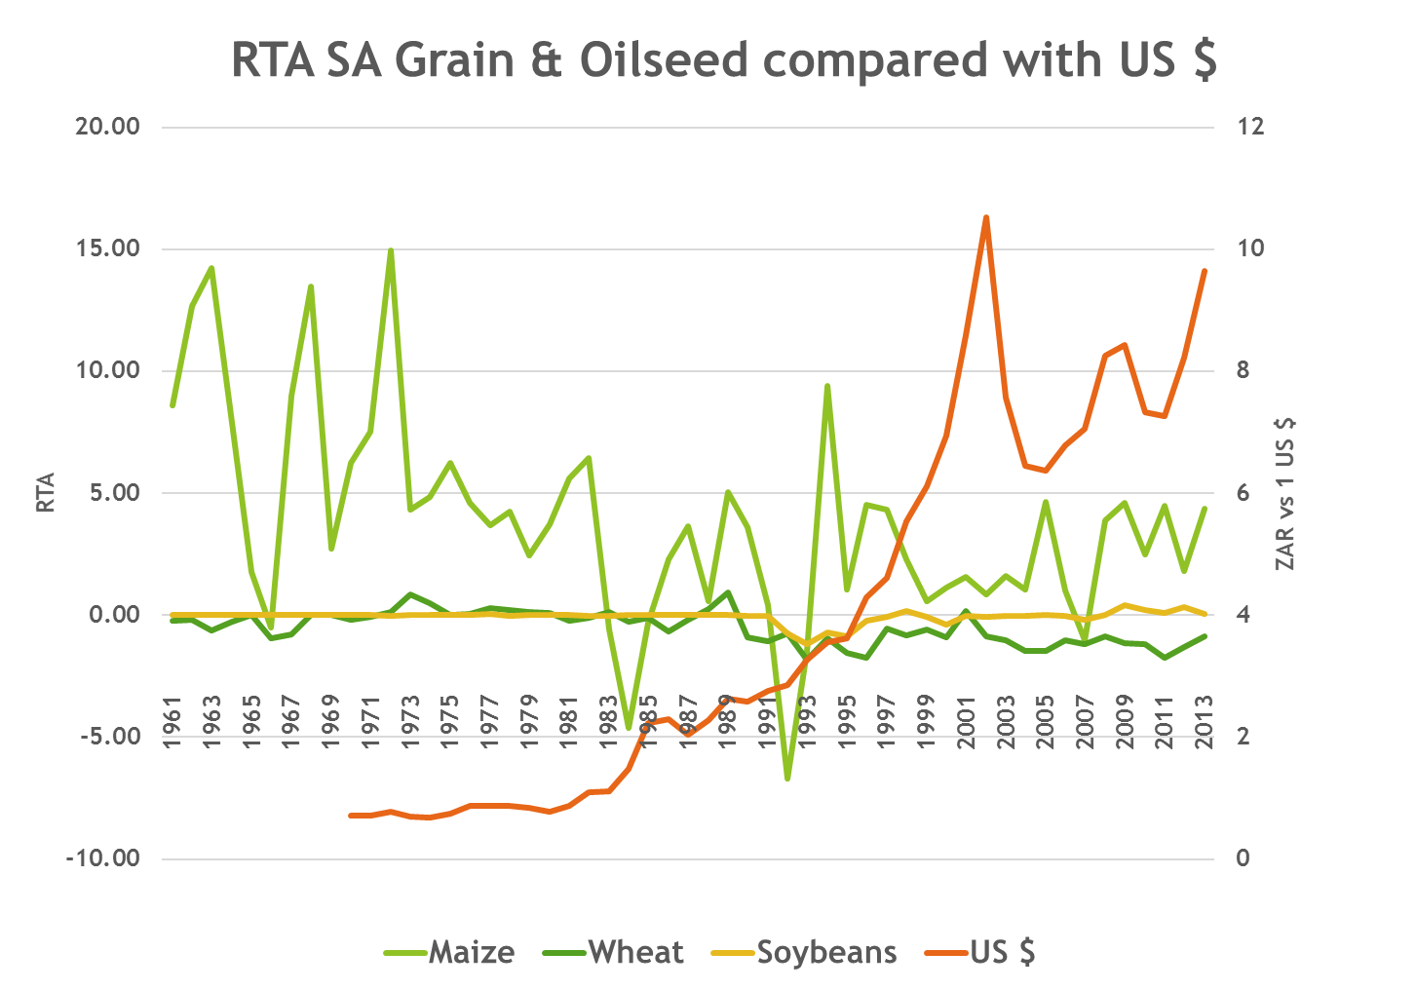

Slide 25
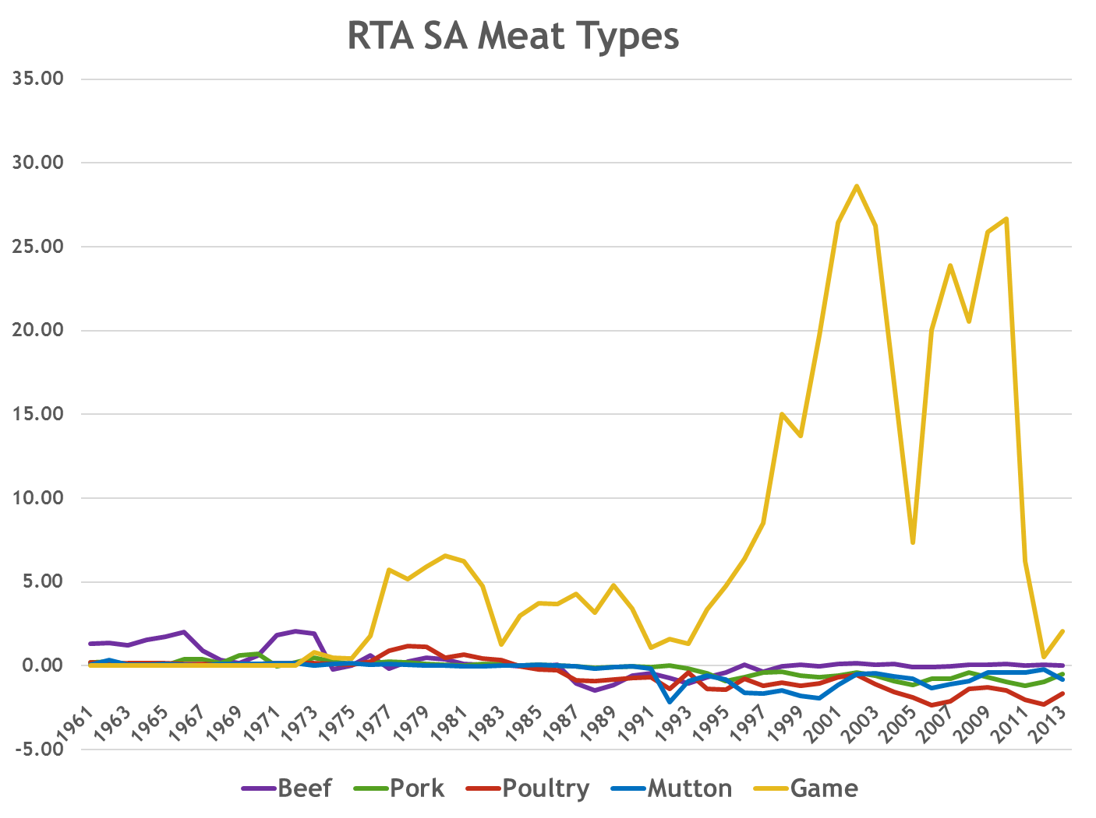

Slide 26
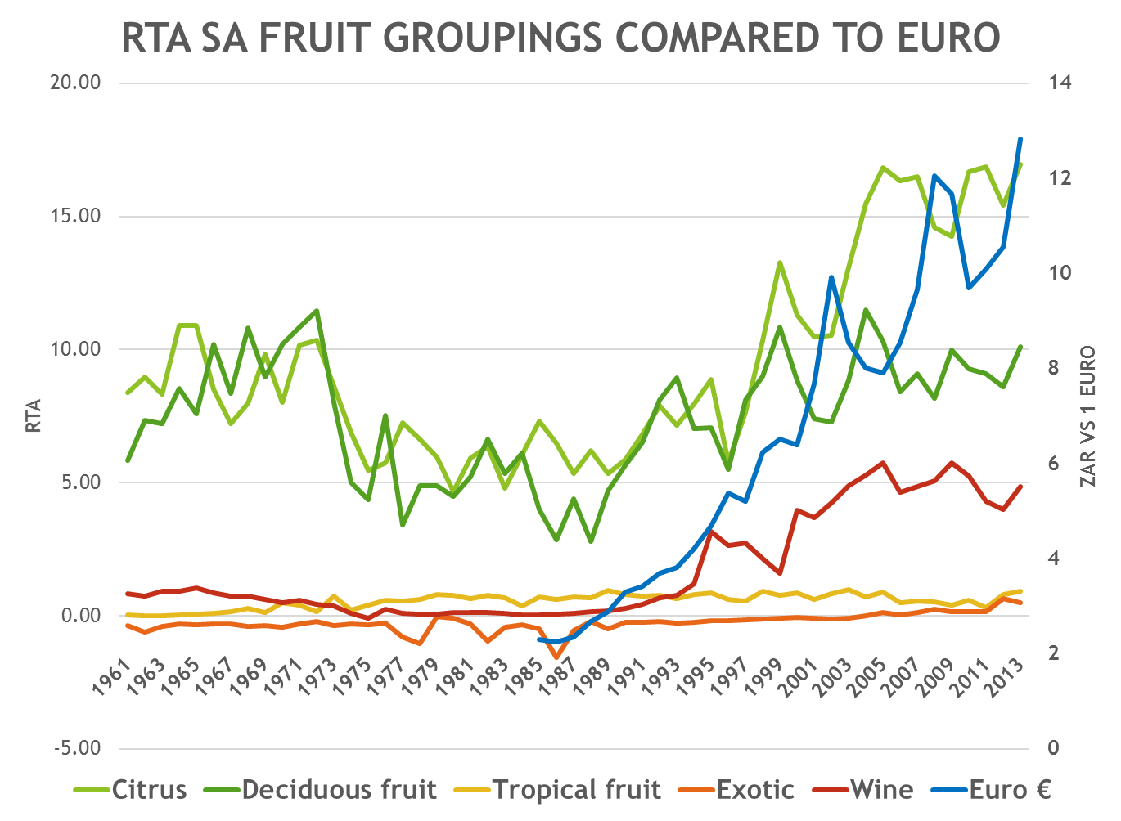

Slide 27
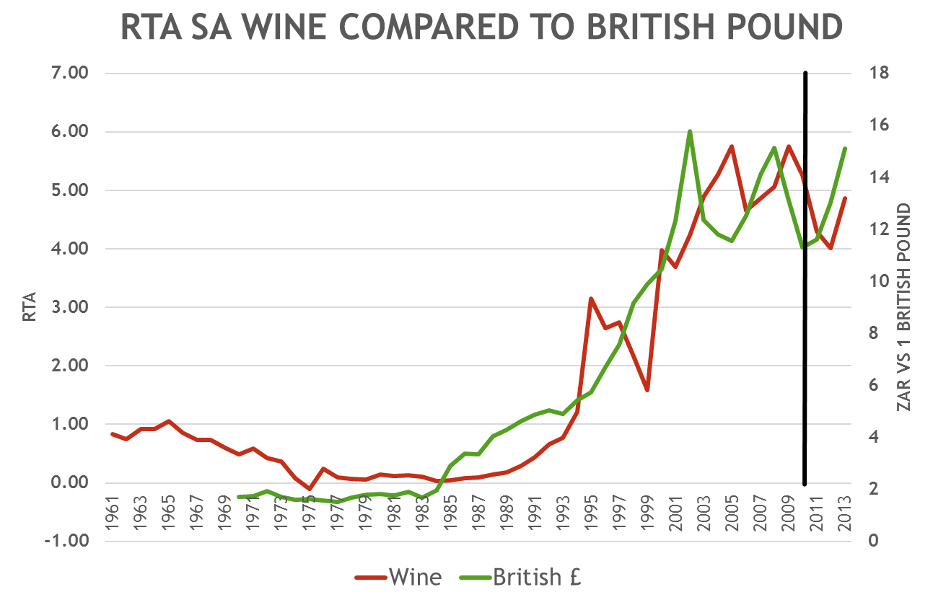
Phase 1
Phase 2
Phase 3
Phase 4
Phase 1: Regulated, constrained
Competitiveness; economic sanctions
Phase 2: The Madiba Magic Period – learning the trade (1990-2001)
Phase 3: Towards becoming a global player (2001 -2010)
Phase 4: Operating in a constrained competitive environment ( 2010 -)

Slide 28
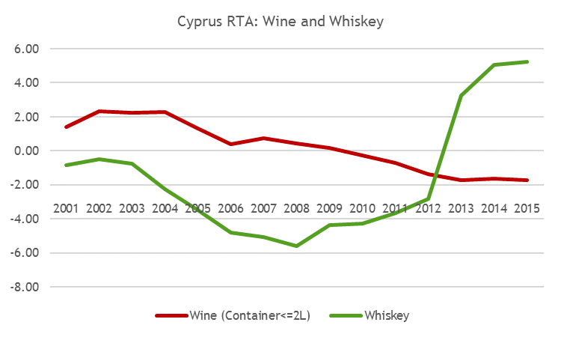
Cyprus Agricultural Industry
RTA’s: Wine and Whiskey (ITC Data)

Slide 29
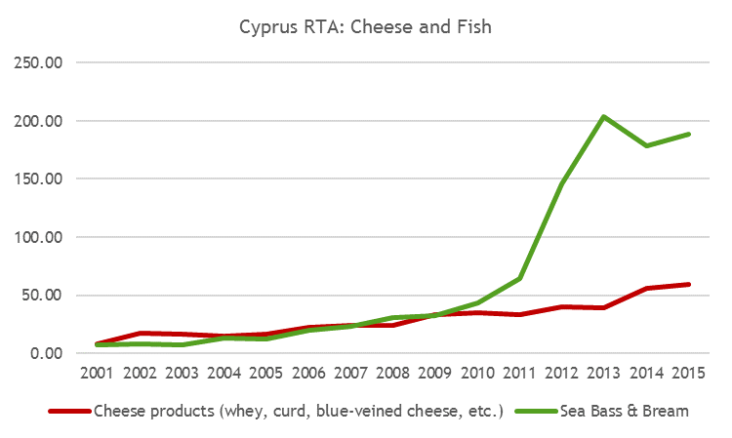
Cyprus Agricultural Industry
RTA’s: Cheese and Fish (ITC Data)

Slide 30
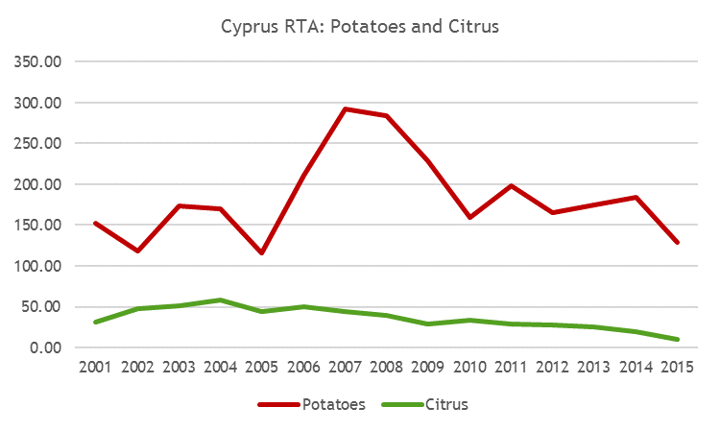
Cyprus Agricultural Industry
RTA’s: Potatoes and Citrus (ITC Data)

Slide 31
Step 3: Which factors determine industry level competitive performance?
Executive Survey (views industry leaders, investors, producers, ceo’s):
- Identify the major operational factors affecting
competitive performance (2015 Deciduous Fruit
Industry Exec Survey; Wine Exec Survey, etc)
Determine views in value chain clusters:
- “Trade” respondents in export, trade and marketing
- ”Agribusiness” respondents in primary production,
input supply, storage, winemaking,

Slide 32
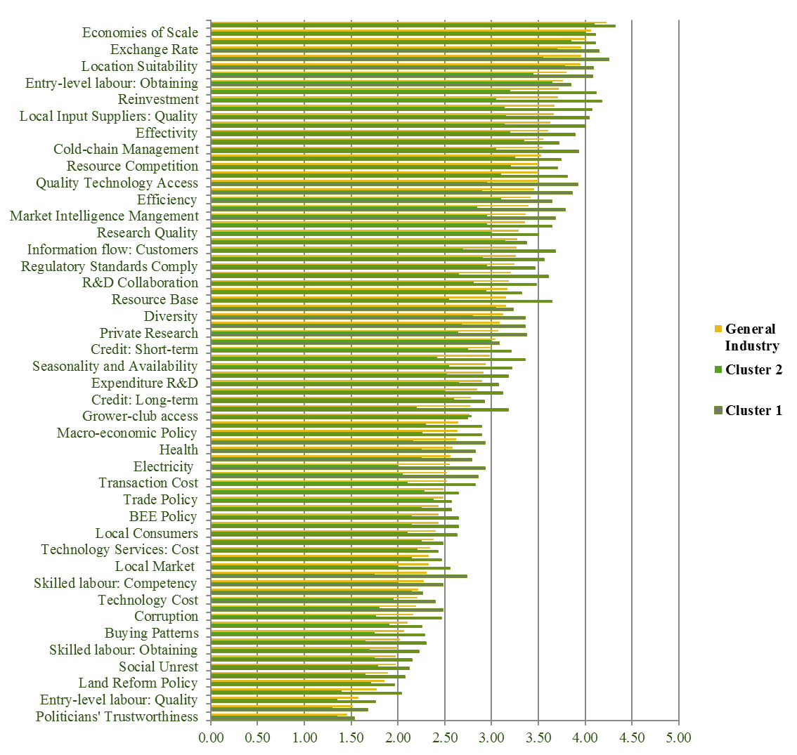
10%

Slide 33
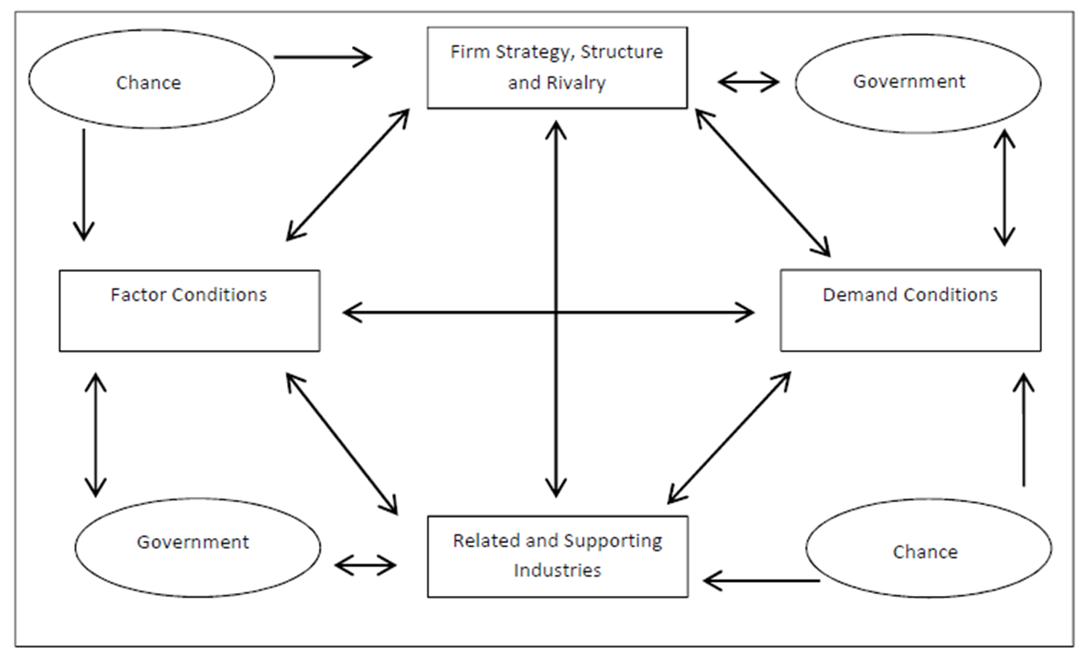
Step 4:Determinants of Competitive Industry Performance(The Porter Diamond)

Slide 34
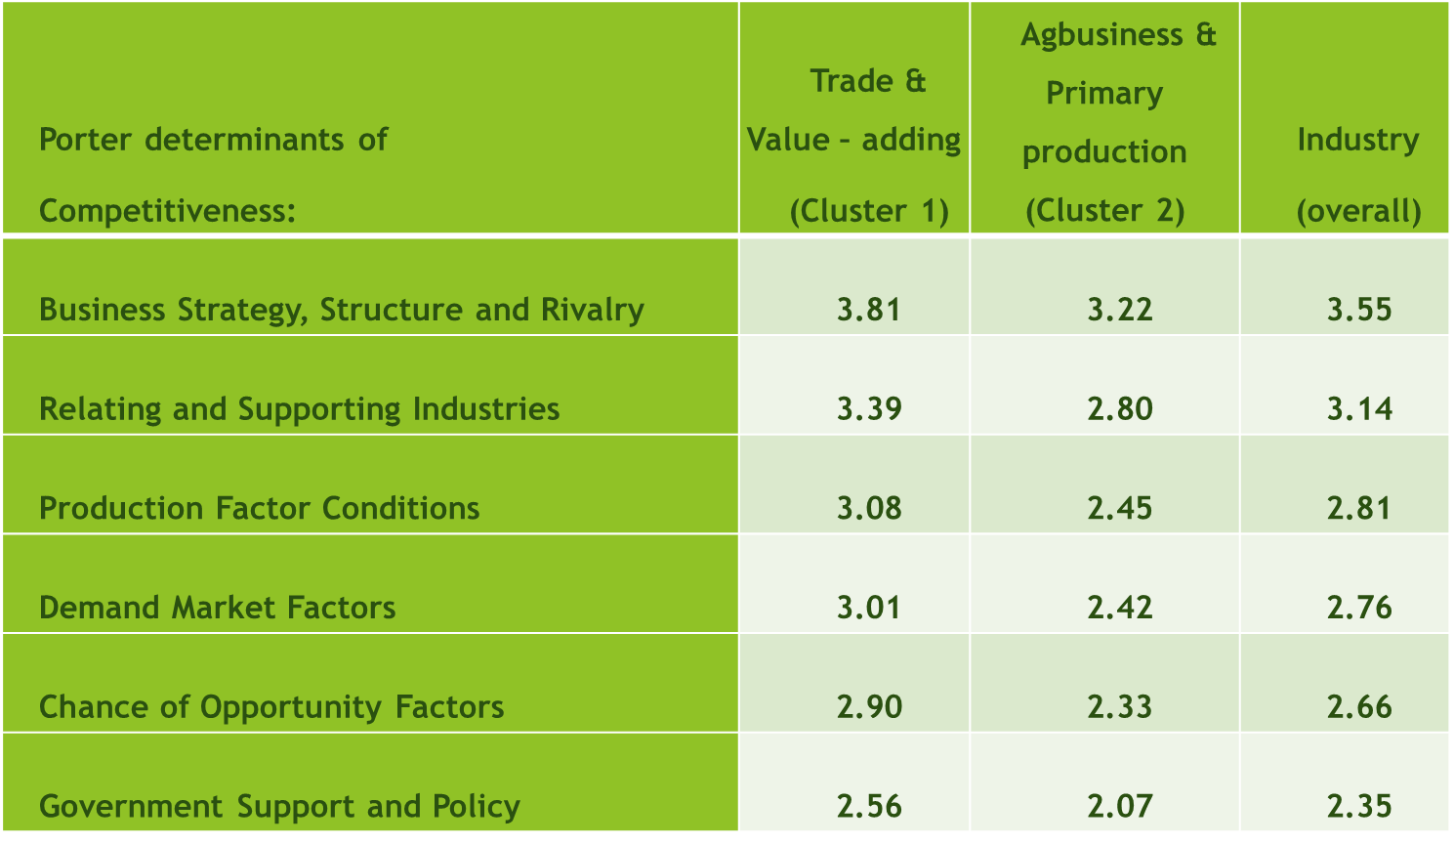
Step 4: The major determinants of competitiveness –
Porter Diamond Analysis, 2015

Slide 35
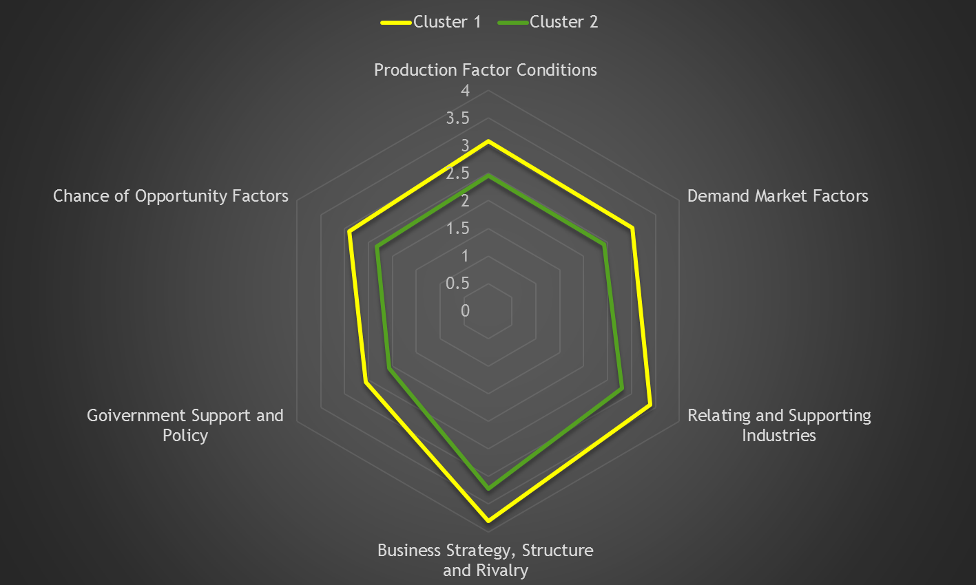

Porter Diamond 2015

Slide 36
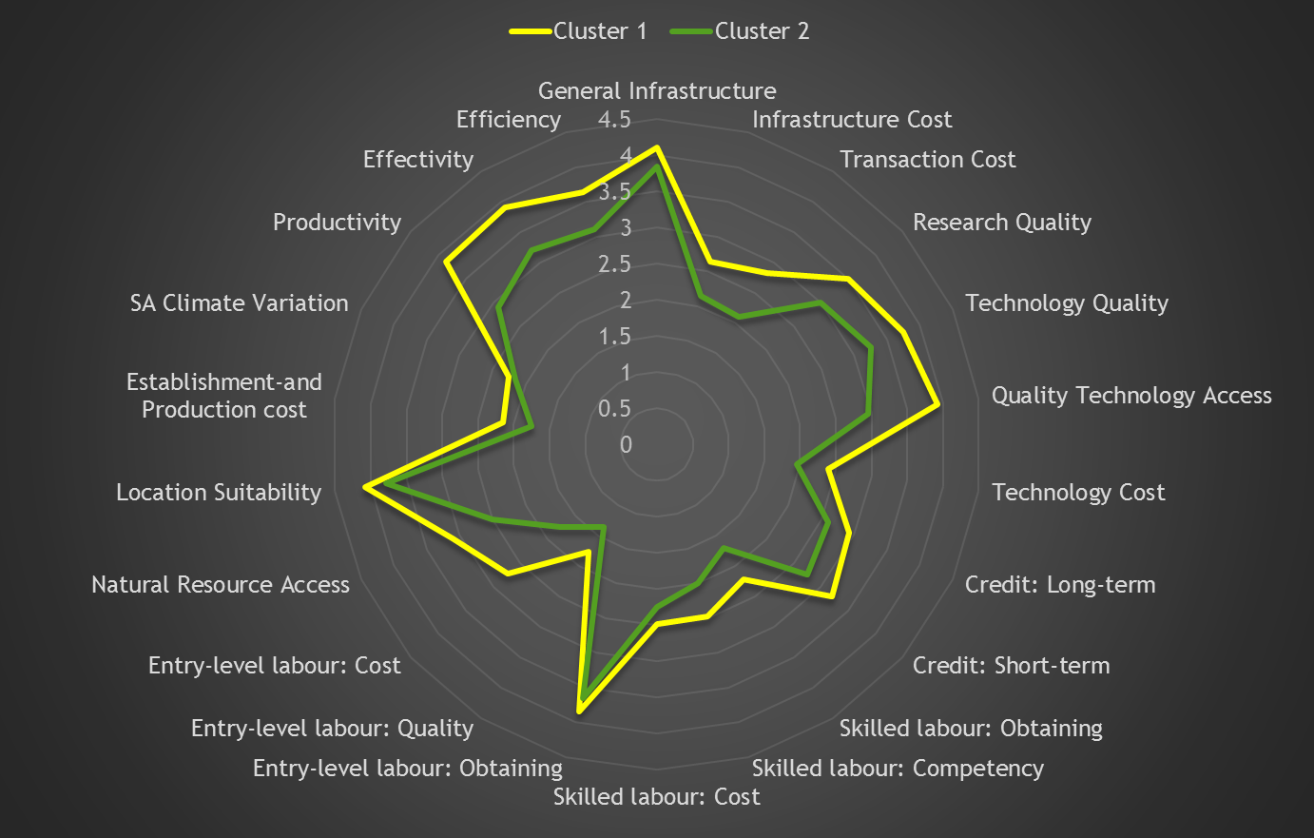

Production factor conditions

Slide 37
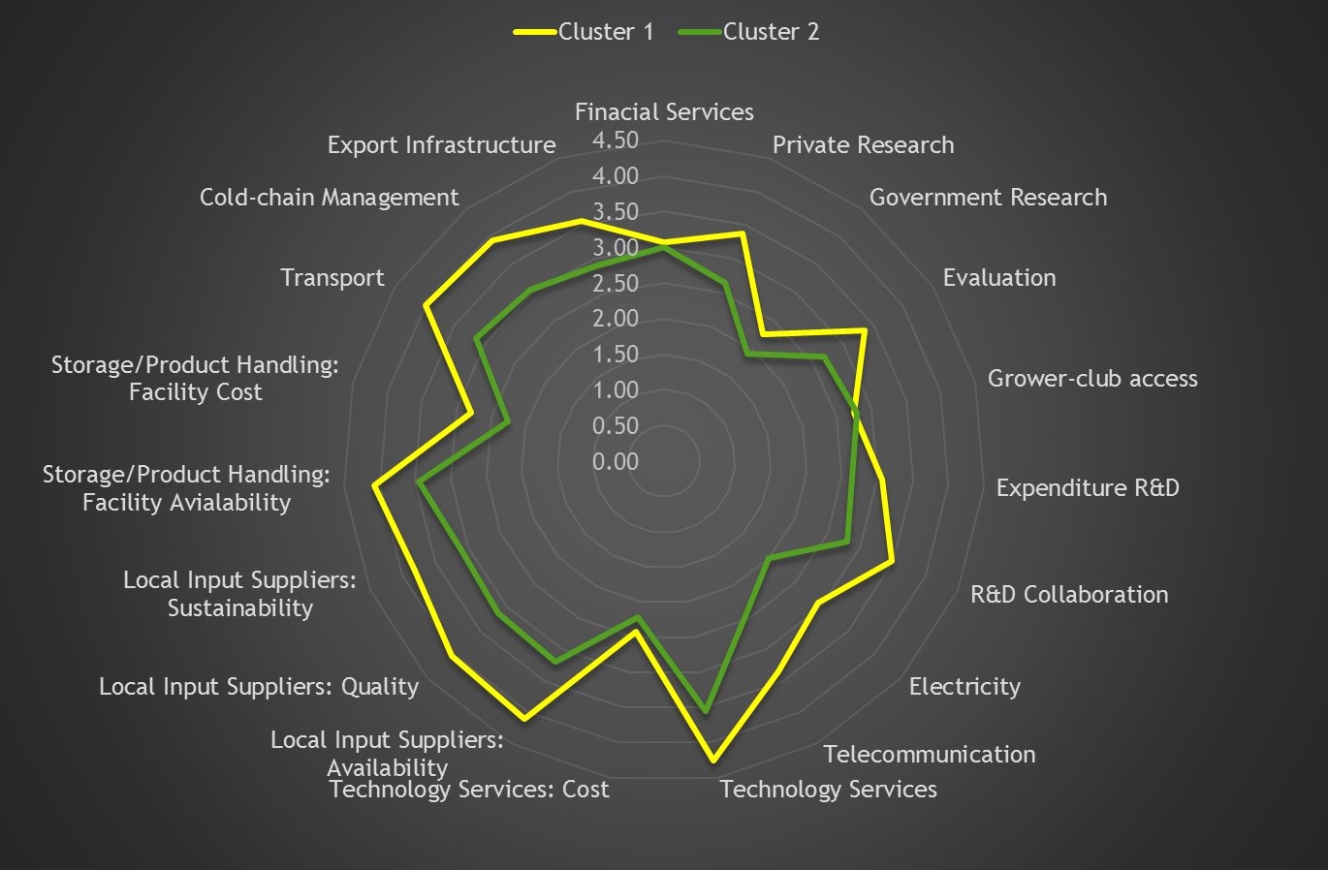
Relating and supporting industries

Slide 38
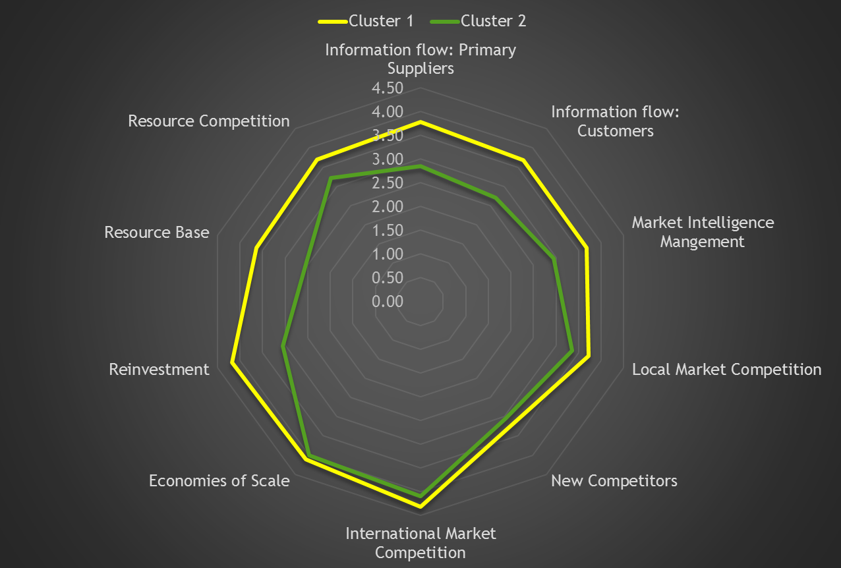
Firm strategy, structure and rivalry

Slide 39
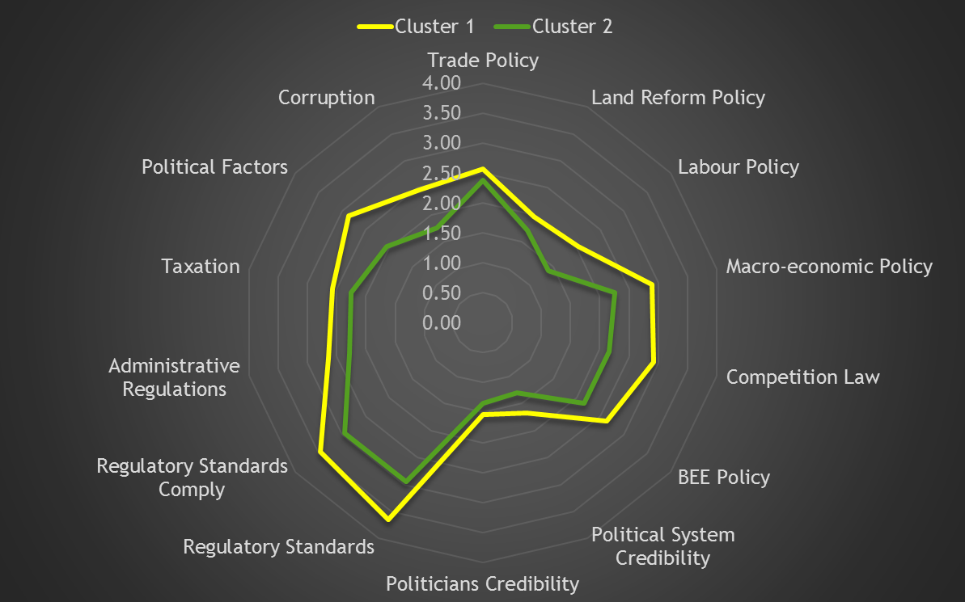
Government support and policies

Slide 40
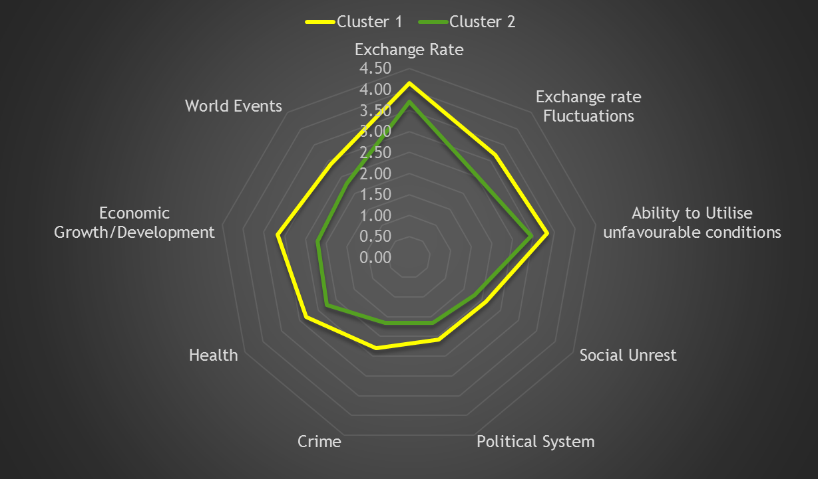
Chance factors

Slide 41
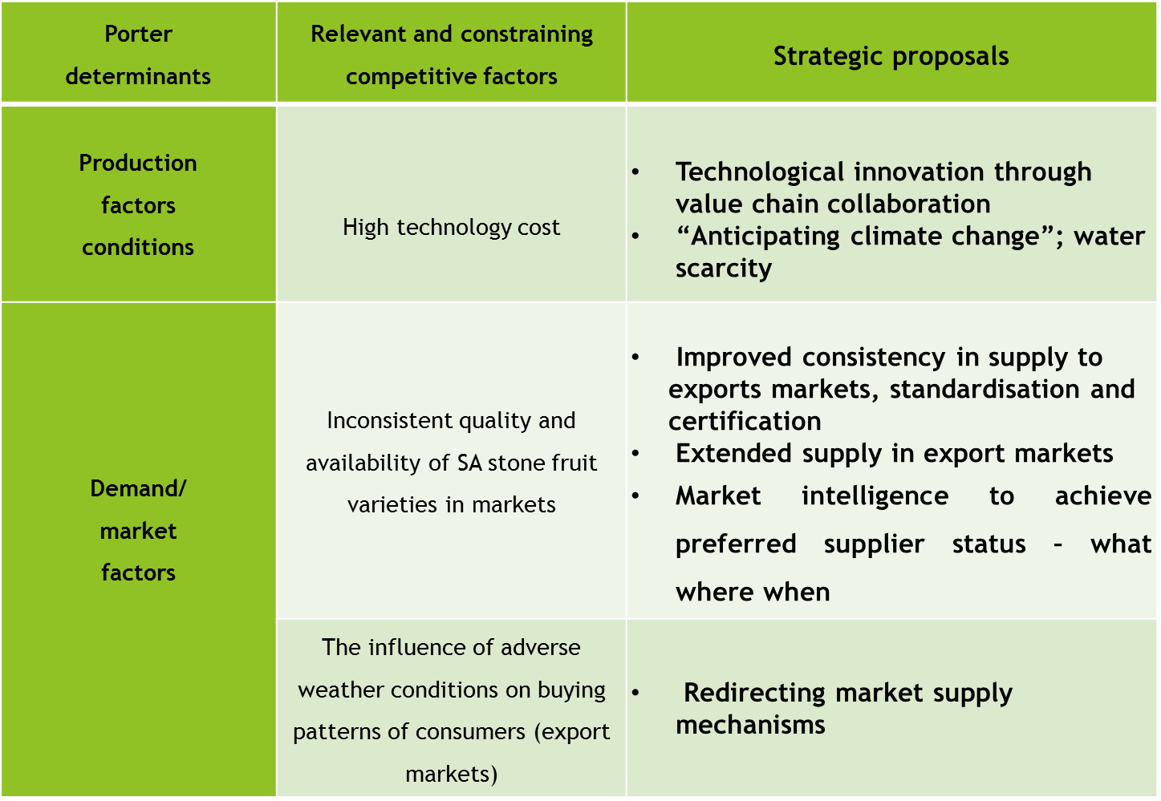


STEP 5 - COOPERATIVE AGENDA SETTING:
SA DECIDIOUS FRUIT INDUSTRY

Slide 42
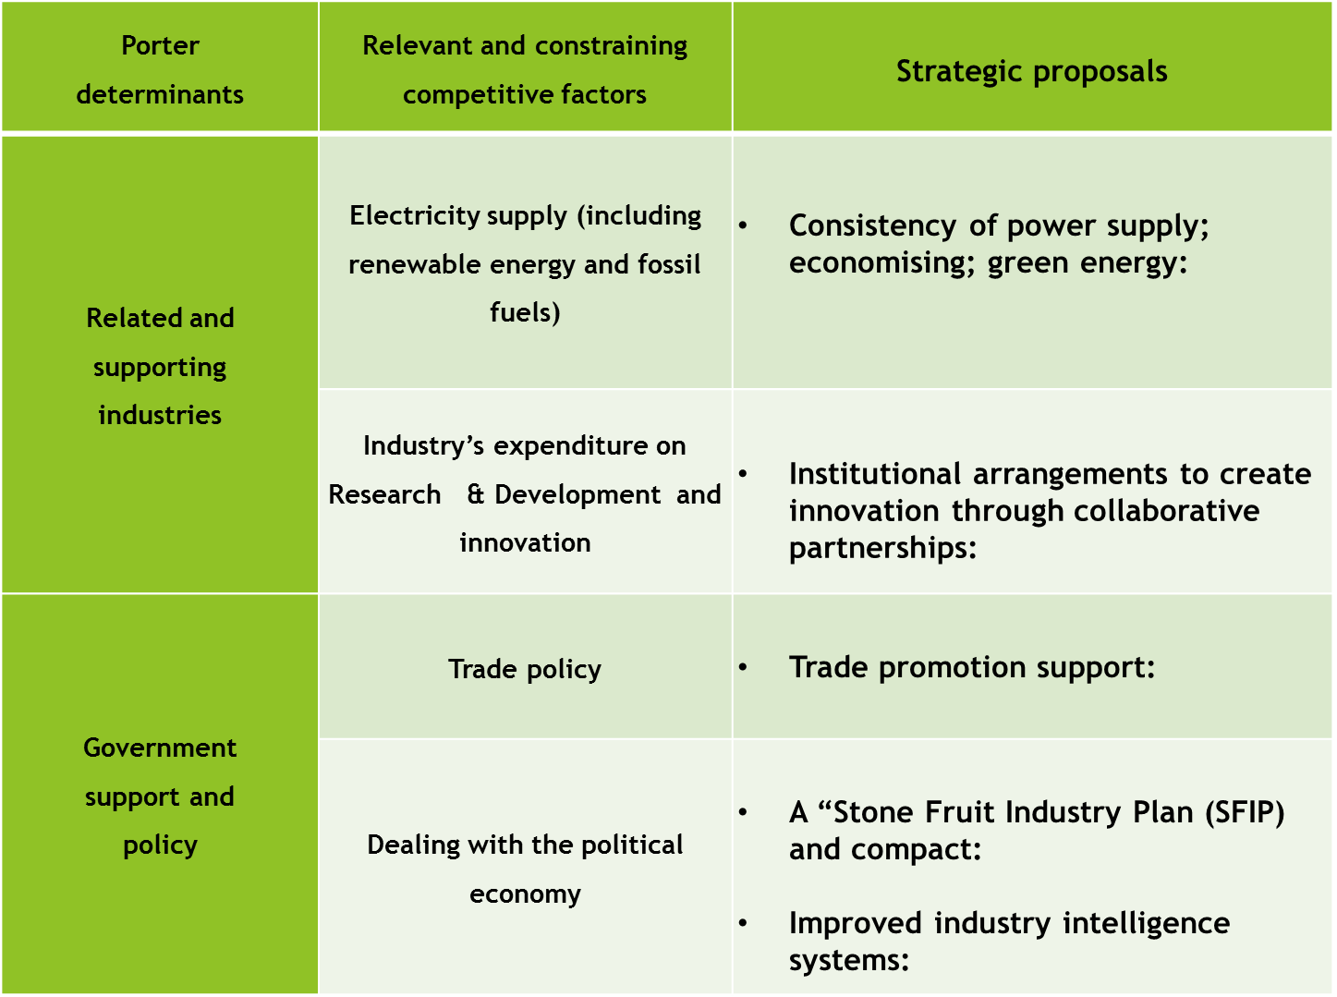

Slide 43
New research directions
Move from general to specifics: Focus on form, place and time utilities in different markets. Market analysis - “Decision Support Models” “Market Attractiveness Index” - to identify and analyse new, lucrative markets for competitive products
Expand into value chain benchmarking:
- ID production factors constraining competitiveness at particular levels/functions in the value chain - on-farm level, processing, retail - local level comparisons and global through “benchmarking” & “double and triple” Porter diamonds.
- and conduct intra-value chain competitiveness: Give effect to differing views of different functional groups in the chain – intra-value chain investigation; weighting of Porter factors (Kothandaraman & Wilson, 2001; Lia, & Whalleby, 2002, Angala 2015 and Boonzaaier 2015)

Slide 44
New research directions
“Future-based Enquiry”:
“In the business world the rear-view mirror is always clearer than the windshield” (Warren Buffet). Only historical trends analysed by RTA; Porter models.
Move towards prognostic analysis; not only diagnostic evaluation. Scenario development and “Agri- industry Business Confidence Indexes” (Esterhuizen, 2006) to predict expected variations be explored
Agri-sector analysis:
Focus on “winning and losing” industries to direct policy support systems
and investment decision-making

Slide 45
CONCLUDING REMARKS:
1. THE AGRICULTURE SECTOR IS NOT A UNITARY SYSTEM; RATHER A SECTOR WITH COMPLEXITY & DIVERSITY WITH MANY COMPLEMENTARY, COMPETITIVE AND SUPPLEMENTARY RELATIONSHIPS; A BIT “NON SENSICAL TO TALK ABOUT AGRI-COMPETITIVENESS per se
2. CONTEXUALISE COMPETITIVENESS PERFORMANCE IN TERMS OF THE PREDOMINANT FOCUS OF A PARTICULAR INDUSTRY AND ITS RELATIONSHIPS – COMMODITY GROUPS, TRADE ORIENTATION, MARKETS, RIVALRY, STRUCTURE, ETC – NO ONE MODEL FITS ALL
3. ENGAGE INDUSTRY VALUE CHAIN PLAYERS (GLOBAL WHERE REQUIRED)– INPUT, PRODUCER, MANUFACTURER, RETAIL – IN COMPETITIVENESS ANALYSIS AND STRATEGY DEV – SOLVE THE WEAKEST LINKS; BUILD ON STRONG POINTS.

Slide 46
CONCLUDING REMARKS:
4. USE TREND ANALYSIS TO DESIGN CONSISTENCY AND RELIABILITY IN STRATEGY/ LOBBY EFFORTS
REFRAIN FROM OPPORTUNISTIC BEHAVIOUR FOCUSING ON “QUICK FIXES”.
TRENDS REFLECT “SPILL-INN” DYNAMICS. i.e. Chance factors such as Westerns Europe low wine crop + SA bumper crop in 2008 = positive impact over next few years for SA wines.
6. BUILT TRUSTFUL AND TRANSPARENT INDUSTRY STRUCTURES AND
RELATIONSHIPS – AVOID OPPORTUNISTIC BEHAVIOUR; SHARE INTELLEGENCE AND DATA SETS; MONITOR, MEASURE , ANALYSE.

Slide 47
CONCLUDING REMARKS:
FARM LEVEL STRATEGIES:
- Be careful for long term investments in marginally competitive industries
- Consider size and scale:
# Large scale mega farmers - similar to industry type of considerations
# Medium scale farmers –take a “small business” focus re cash flows and risks; link into competitive value chains; serve niche markets – GI’s; S & C
# Smallholders – remember “efficient but poor ” hypothesis: seek niche markets; link into competitive value chains- out grower schemes; onsider part-time farming (divert time to activities that secure income such as off farm employment, rural tourism); rent land to larger farming firms, etc.

Slide 48


SOME WORDS OF WISDOM
“In today’s (agri) business, the competition will bite you if you keep running; if you stand still they will swallow you!”
(William Knutsen, Jr. Chairman, Ford Motor Company)
RITY FOCUS

Slide 49

THANK YOU – COOPERATIVE CENTRAL
BANK & UNIVERSITY OF CYPRU
BE COMPETITIVE!

